Slide 1
ADDING ATTACHMENTS TO YOUR WINLINK MESSAGE
KB7RHI

Slide 2
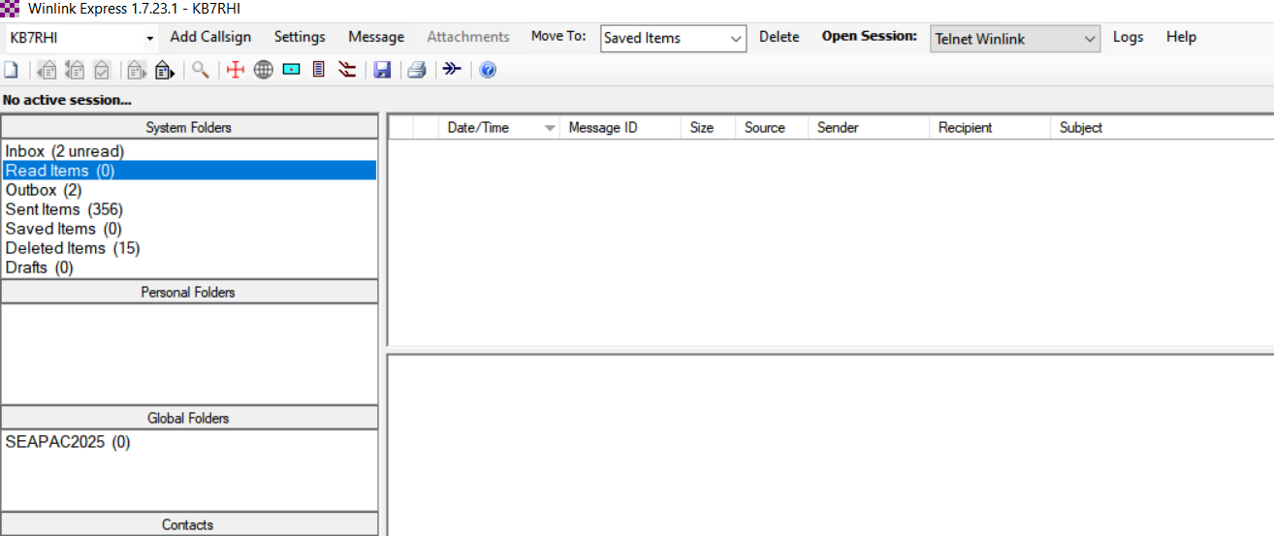
Open up a new message from the main Winlink Express page, click on “Message”

Slide 3
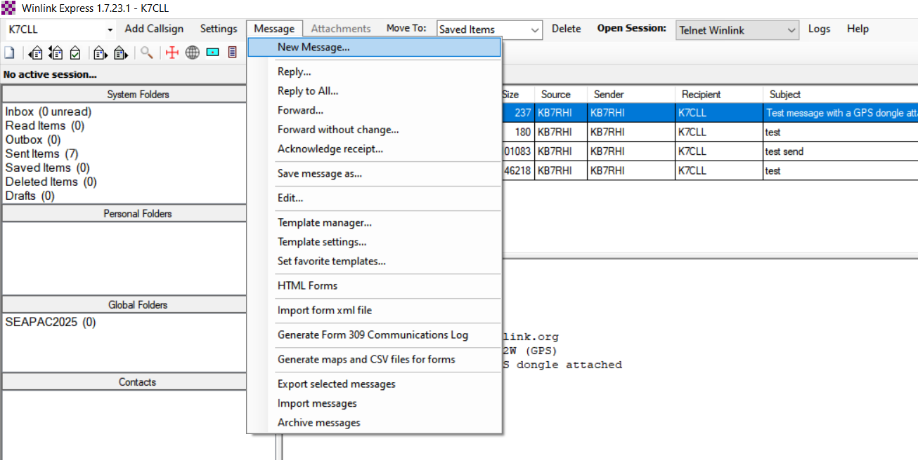
Select “New Message…”

Slide 4
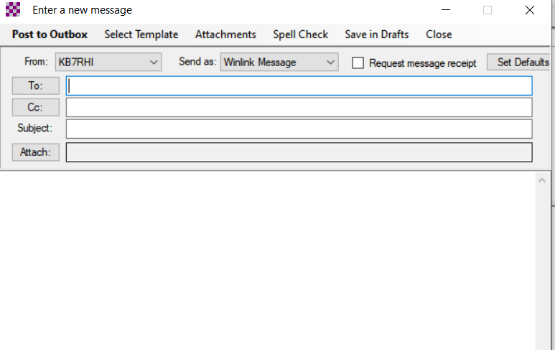
Click on “Attach” or “Attachments”…both take you to the same next step

Slide 5
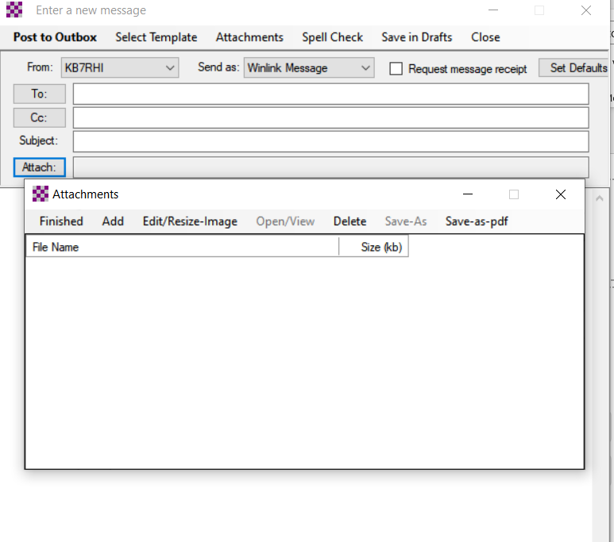
Click on “Add”

Slide 6
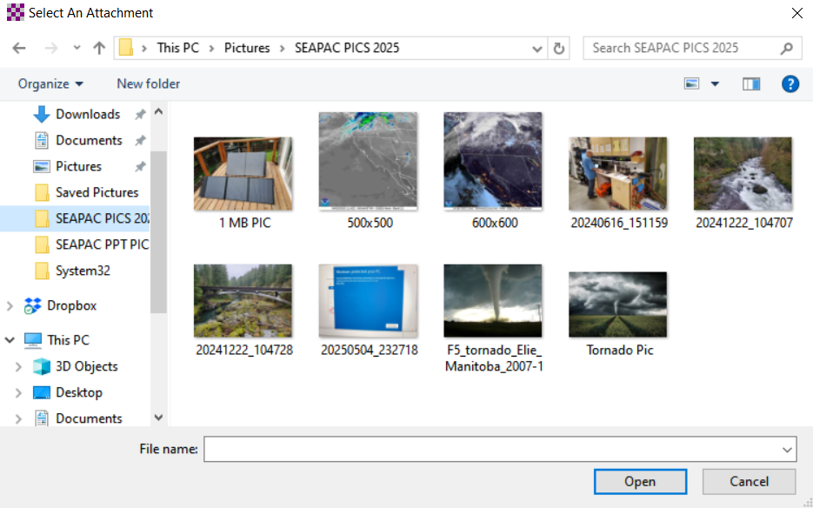

Find the picture/file you want to send

Slide 7
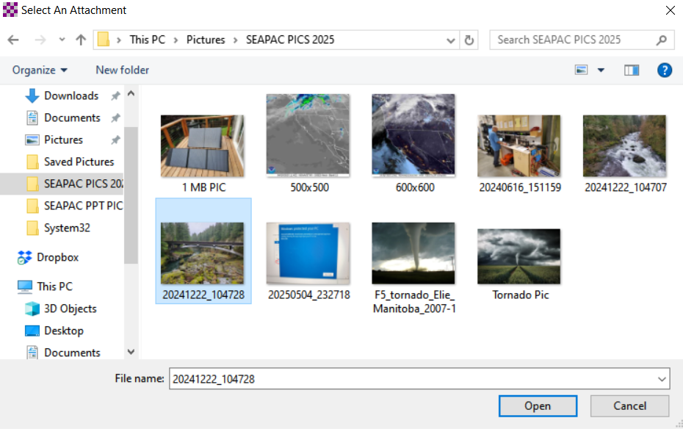
Click on the file(picture) you want to select, you will note “File name” box now has your selection

Slide 8
Next click on “Open”

Slide 9
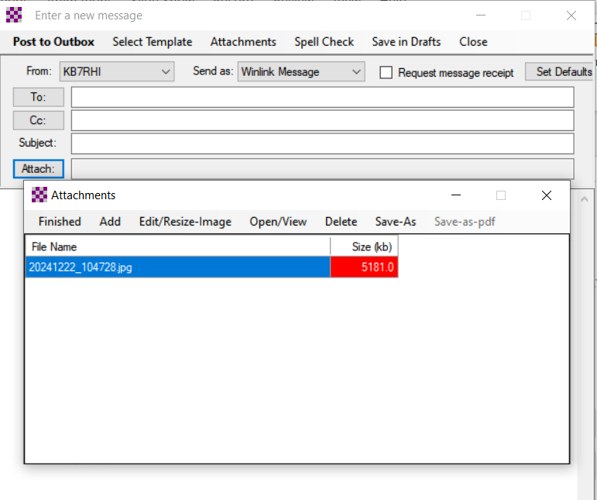
Note that the file size is colored red…your phone pic size is too large to send as a Winlink image…you can resize it…5181 kb is too big

Slide 10
Click on “Edit/Resize-Image”

Slide 11
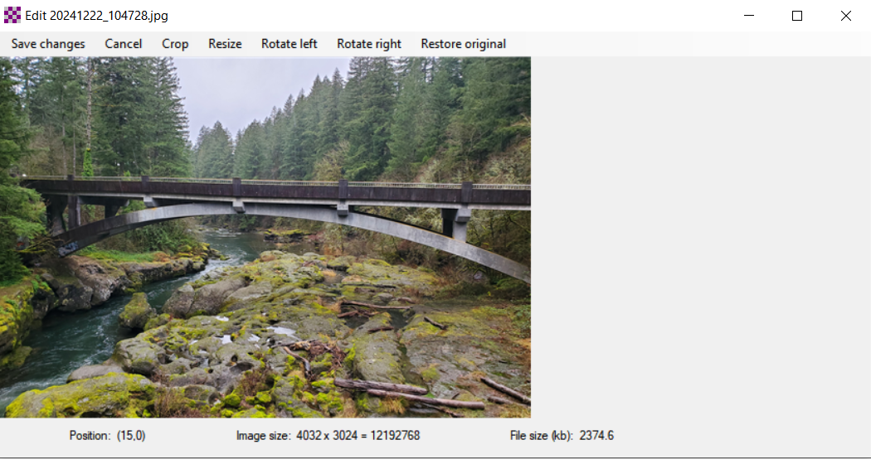
You will now see the menu of choices you can do with your file…we want to click on “Resize”

Slide 12
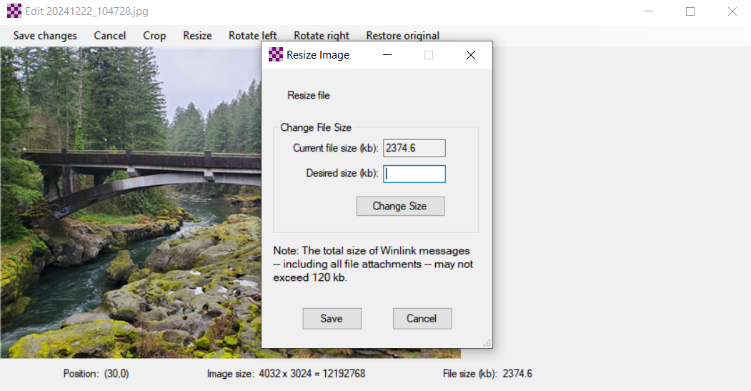

Resize image screen, suggest resizing your pic to 100kb or less…this will allow some text in your message and not exceed the total message size

Slide 13
Enter the size you want in the “Desired size (kb)” Box

Slide 14
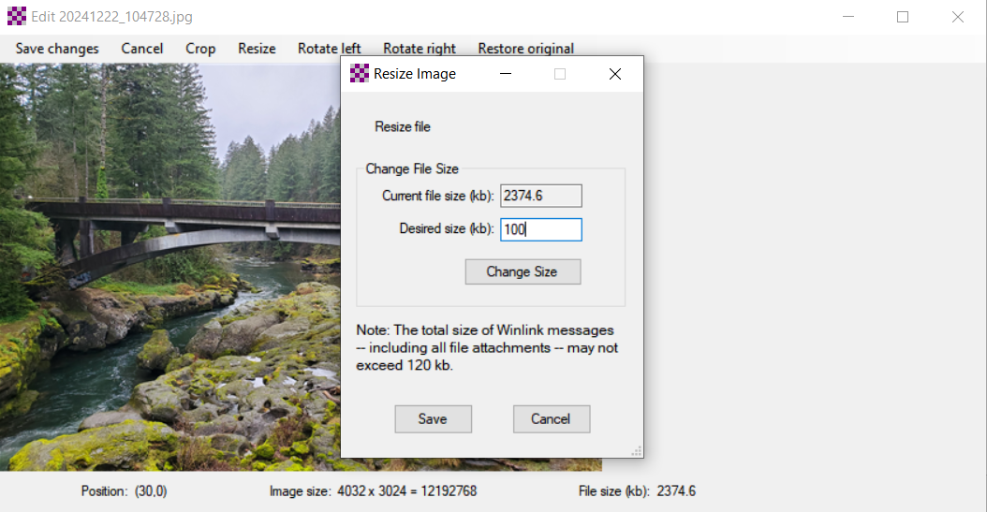
In this example the desired size is 100kb, next click on “Change Size”

Slide 15
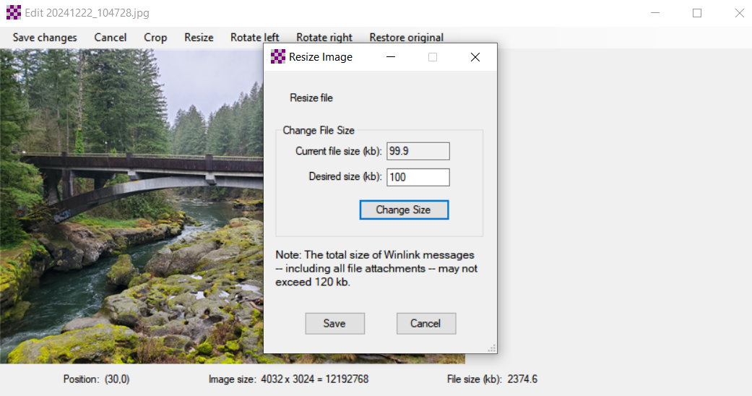
Note the current file size is now 99.9 kb

Slide 16
When you are done editing your pic…then click on “Save”

Slide 17
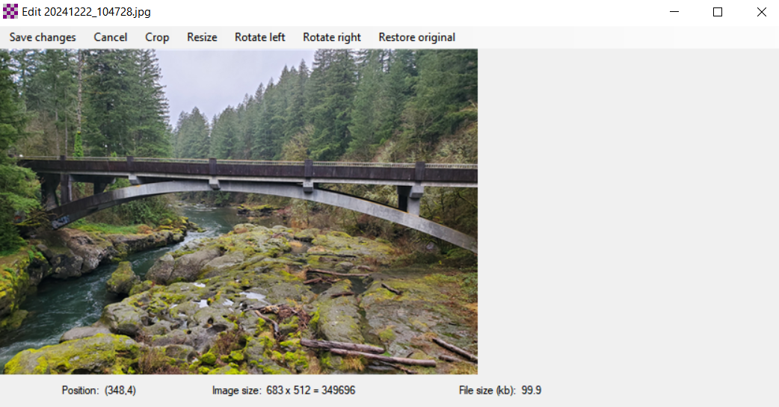
Your editing of the image is now saved…note the image file size in now 99.9 kb

Slide 18
Next click on “Save changes”

Slide 19
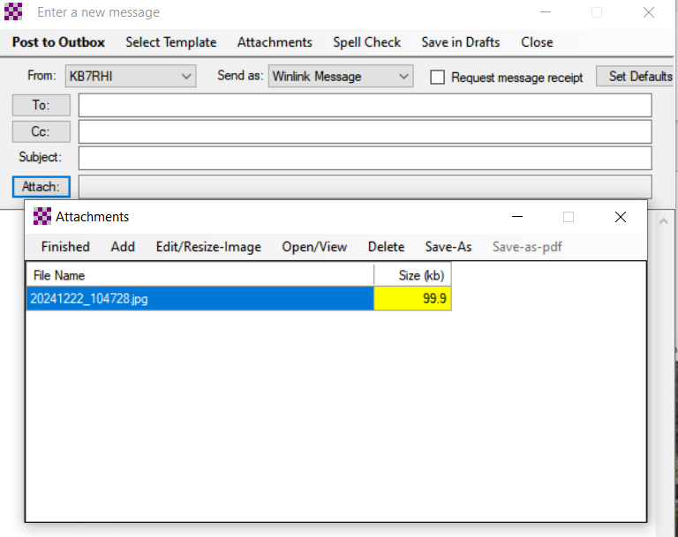
You have added one attachment that is 99.9 kb in size…you could add more images so long as you keep the total size under about 100kb

Slide 20
Final step now to complete adding your attachment is to click on “Finished”

Slide 21
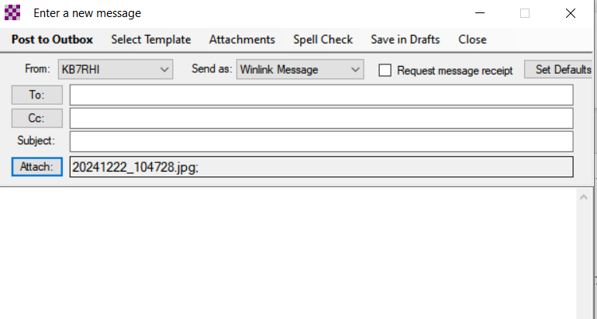

You have completed your attachment, now finish filling out your message

Slide 22
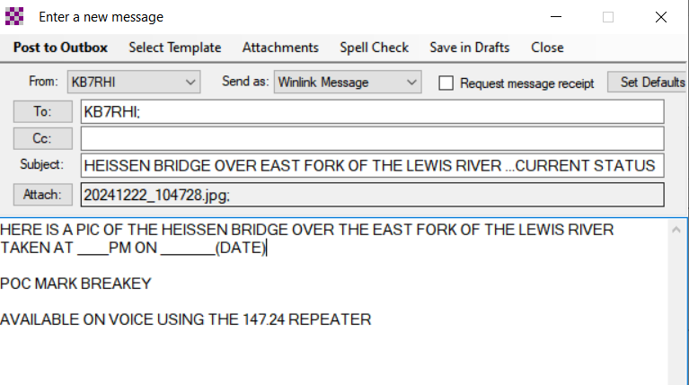
Potential message?…Next step is “Post to Outbox” if the Winlink System is intact…note this is a Winlink Message

Slide 23
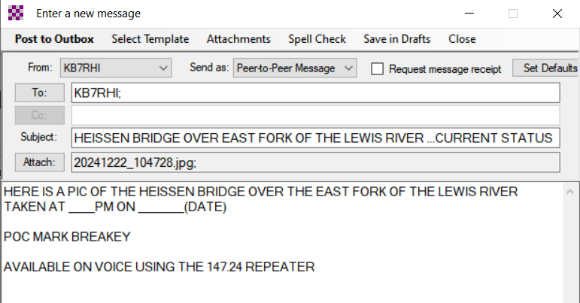
If all communications are down, you can send a direct “Peer-to-Peer Message” to another field station…use drop down menu to select P2P

Slide 24
P2P message with attachment ready to be posted to your Winlink Outbox

Slide 25
Of Note: P2P messages do not have a 120kb limit…not sure of the upper limit
If a major network outage event happens, with P2P, you can attach several good sized images to your message and send them directly to another field station across your county
Using VARA FM Wide, the largest P2P image attachment I have sent was 1MB with a good pathway in just 8 minutes
Once the Winlink programs finishes the initial handshaking…each 100kb in size sends in about 45 seconds with an excellent pathway

Slide 26
A note of caution if using VARA FM to send large messages that may include file attachments
If using a handheld radio and VARA FM to send file attachments…be careful not to try sending too large of a file…handhelds do not have active cooling and some modes like VARA FM will heat up your radio more than you realize
Scott Currie NS7C has reported people with Baofeng handheld radios have burned up their radio while trying to send a large file with VARA FM, there is no temperature protection shut down
It is best to use a radio with active cooling (Fan) with larger file attachments
Mobile radios without active cooling need to be careful…use low power

Slide 27
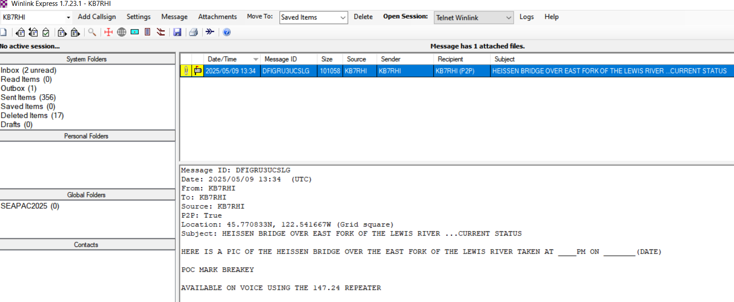
Your message with attachment is now in your Winlink Outbox…note yellow paperclip attachment symbol

Slide 28
Your ready to open a P2P session, select a station call sign and send your message
A picture is worth a “Thousand Words”
If you are able to take a picture of critical infrastructure such as a bridge and send the pic to local civil authorities, you are providing situational awareness ground truth
Local civil authorities are essentially blind as to what extent of damage may have occurred until they see pics
Local authorities may have heard by voice there is damage, you can provide pictures of the damage
Local roads may be a mess, not a good option to send a “Runner” out and back from an EOC location to take pics

Slide 29
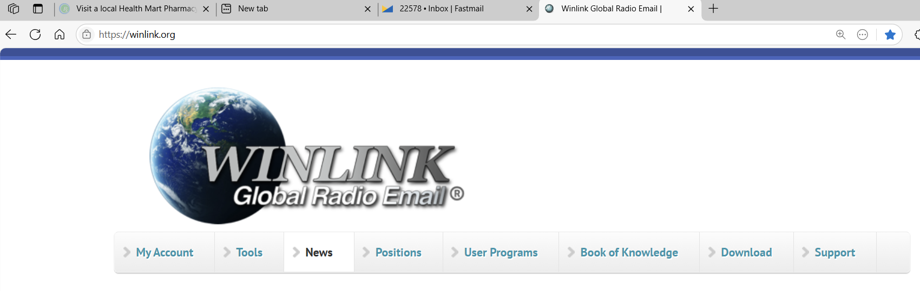
NOTE: If the Winlink system says you have exceeded your personal maximum message size…here is how to change that…Go to the Winlink website and click on My Account

Slide 30
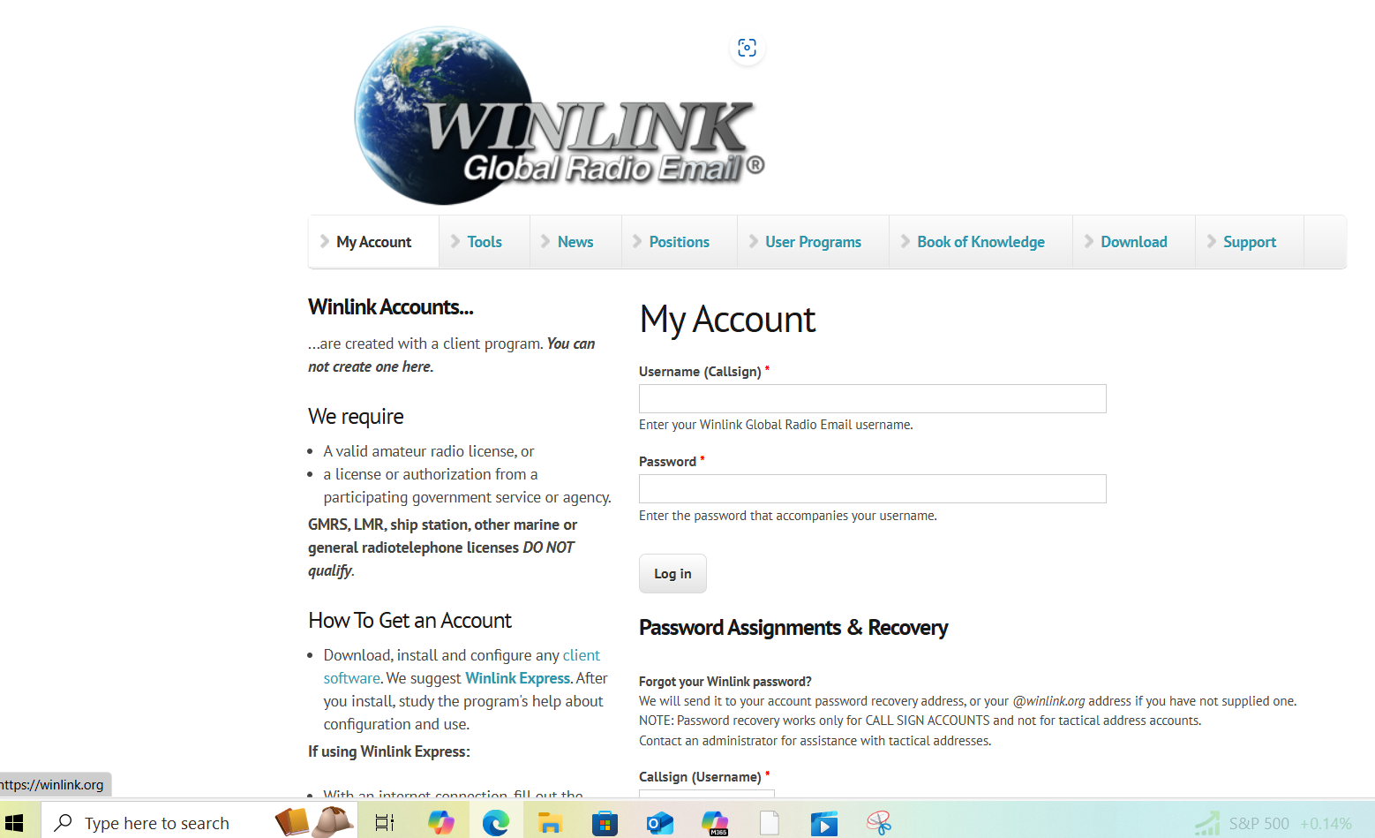

Enter your Winlink callsign and password to login

Slide 31
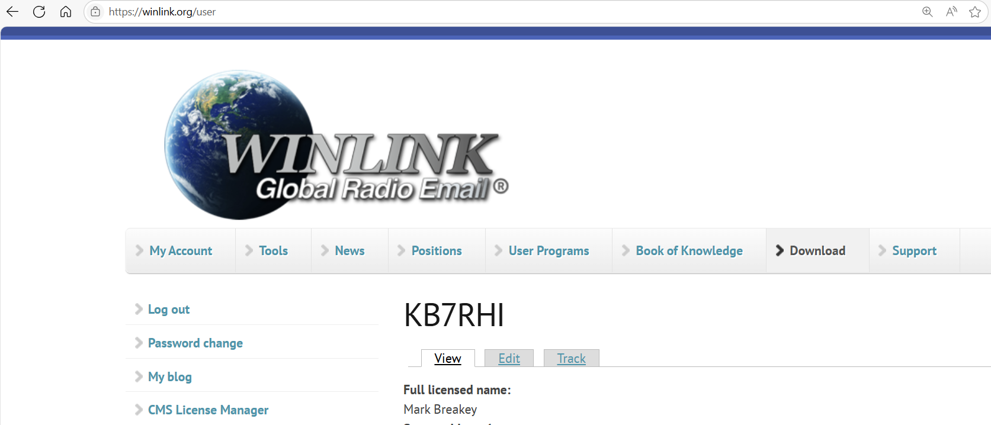
Your account will be in View mode and the max message size will be the last entry…click on Edit

Slide 32
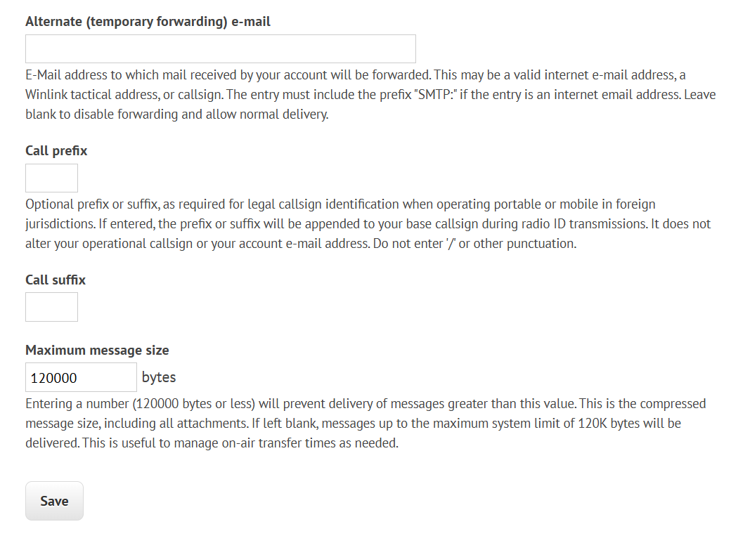

In the Edit mode at the bottom of your listed profile, you can change your Maximum message size to 120,000, this applies to Winlink internet messages, not P2P messages

