Slide 1
Transfer files from your Android phone to your laptop while in the field
KB7RHI

Slide 2
Two methods to tranfer files from your phone to your laptop in the field
Method 1 is to use Bluetooth to transfer the files
Method 2 is to use a cable between your laptop and the phone
Will show first how to transfer a file via BT

Slide 3
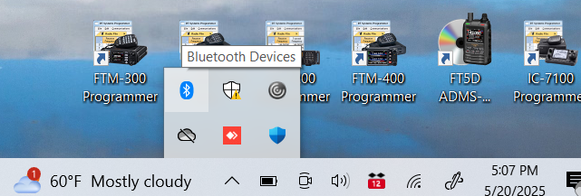


Go to the bottom right of your desktop, click on the up arrow and select the blue colored Bluetooth icon

Slide 4
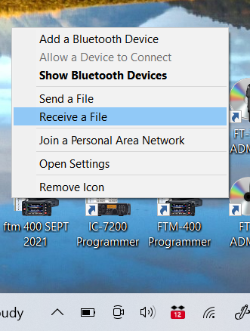
Clicking on the Bluetooth icon opens up this menu…select “Receive a File”

Slide 5
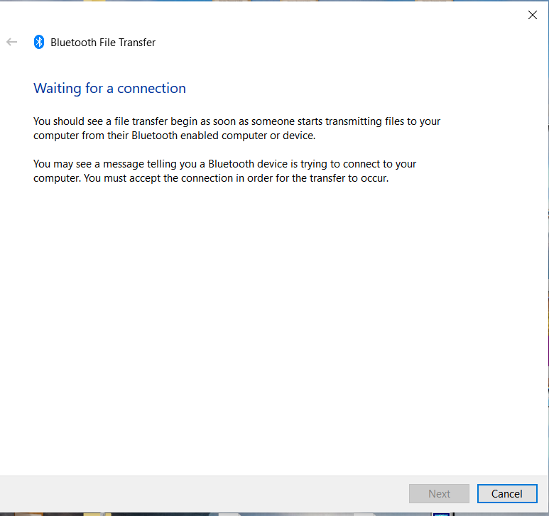
A Bluetooth File Transfer screen will open up

Slide 6
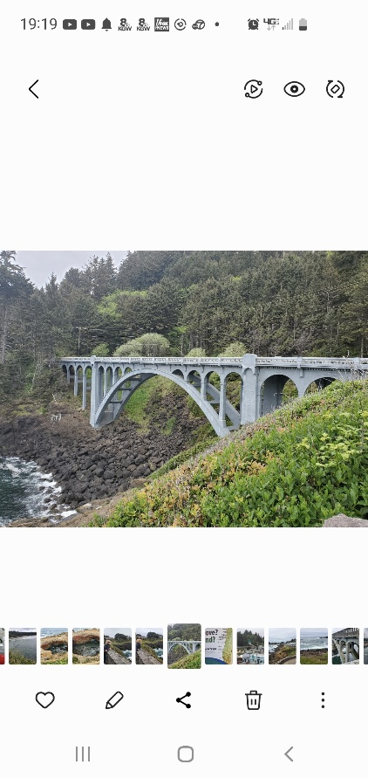
Select a picture that you want to transfer, then click on the share symbol…sideways V

Slide 7
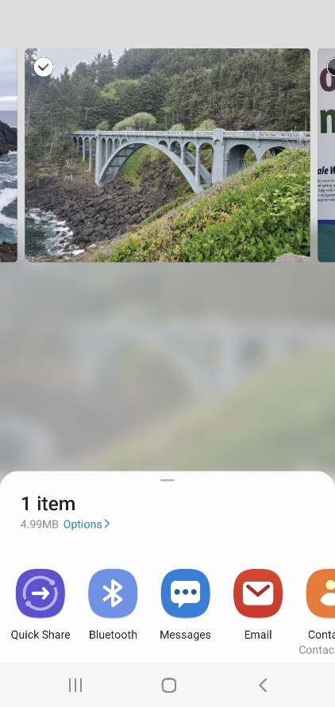

Next scroll across the menu on the bottom of the screen and find the Bluetooth icon, click on it

Slide 8
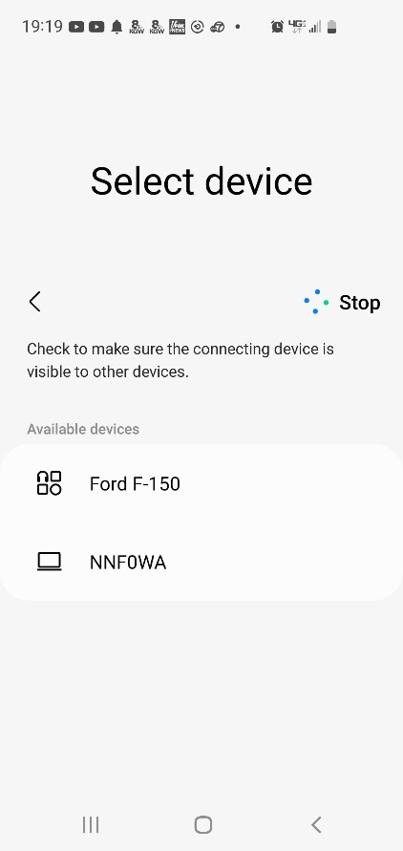
You will be prompted to select which device

Slide 9
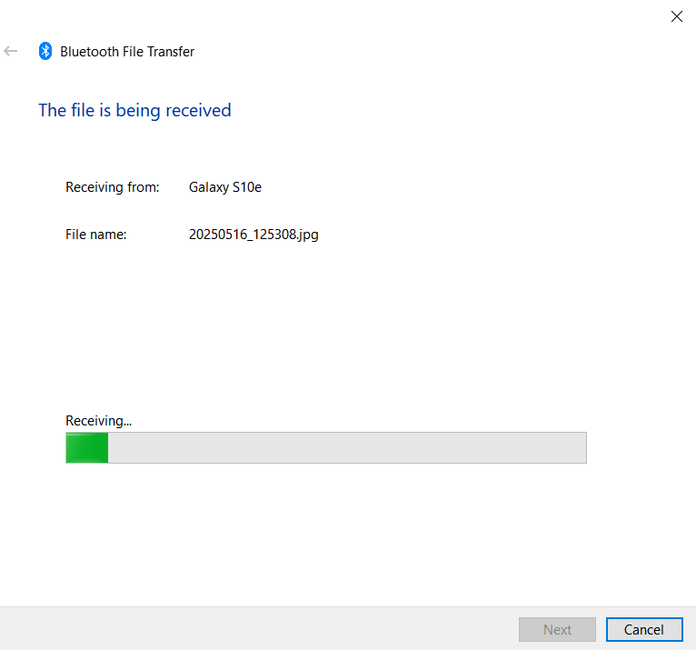
You will then see the progress of your transfer begin with a green bar that goes from left to right

Slide 10
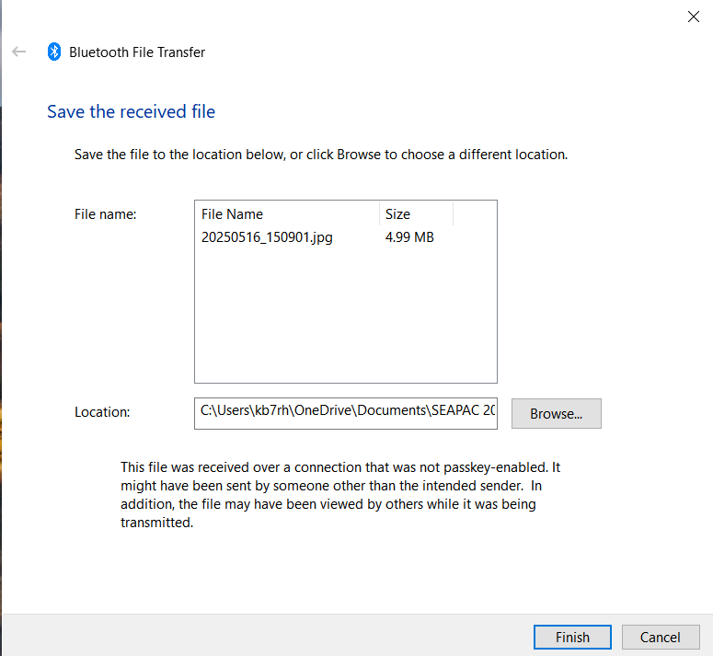
Once the file transfers, you can then click on Browse and select where to save the file…then click on Finish

Slide 11
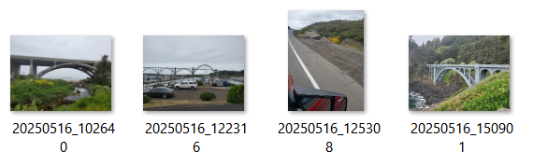

Your file will be saved to a location of your choosing, ready to be your next Winlink attachment

Slide 12
Method 2 is to use a cable between your laptop and the phone
Plug in a USB cable to the phone and then to your laptop
You may hear a connection tone when you plug in the cable to the laptop
You may see a pop up screen on the phone asking, “Allow access to data?” you need to “allow”

Slide 13
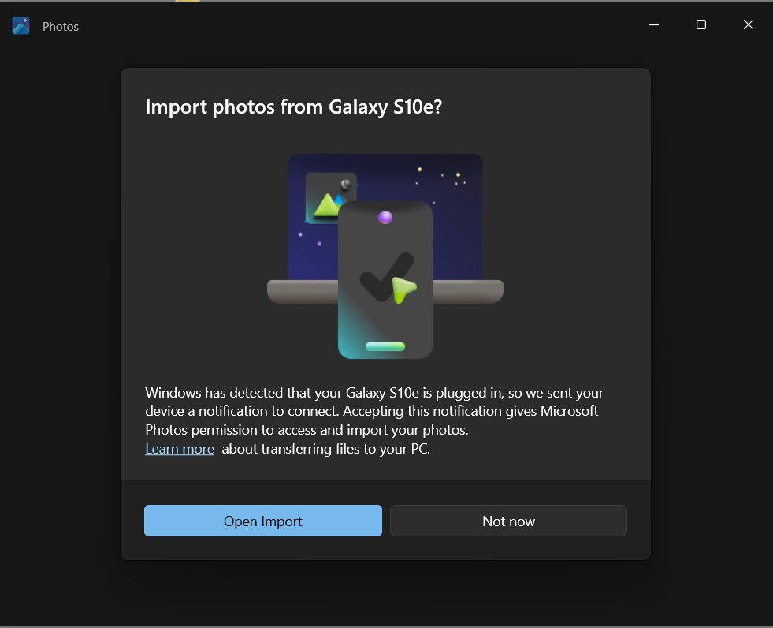
You may see this screen pop up on your laptop…Just close this screen…I am not using it

Slide 14
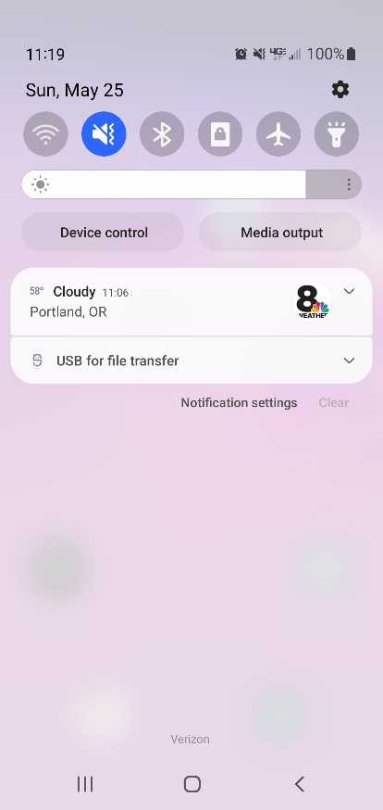
Swipe down on your phone screen for Notifications and tap on “USB for file transfer”

Slide 15
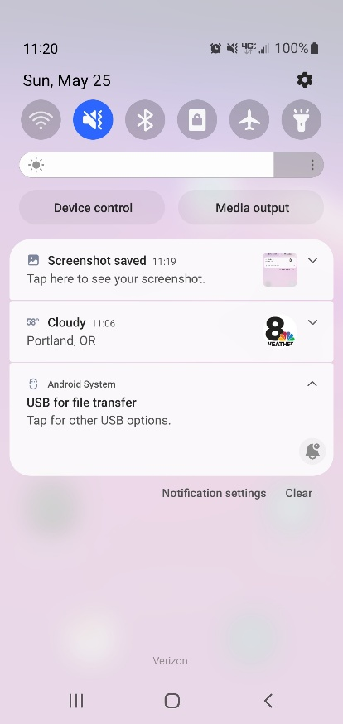

After you tap on the “USB for file transfer”, it will open up to this view, just tap on it again

Slide 16
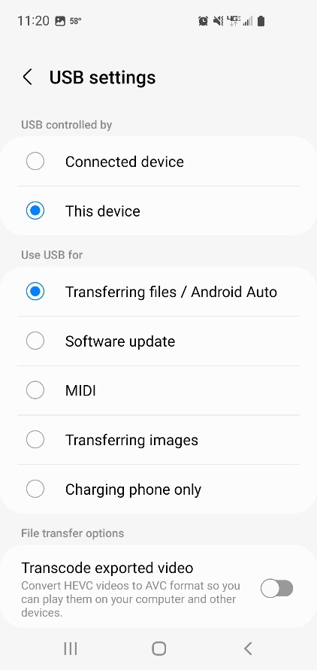
Now note…USB controlled by…”This device”, Use USB for “Transferring files/Android Auto”

Slide 17
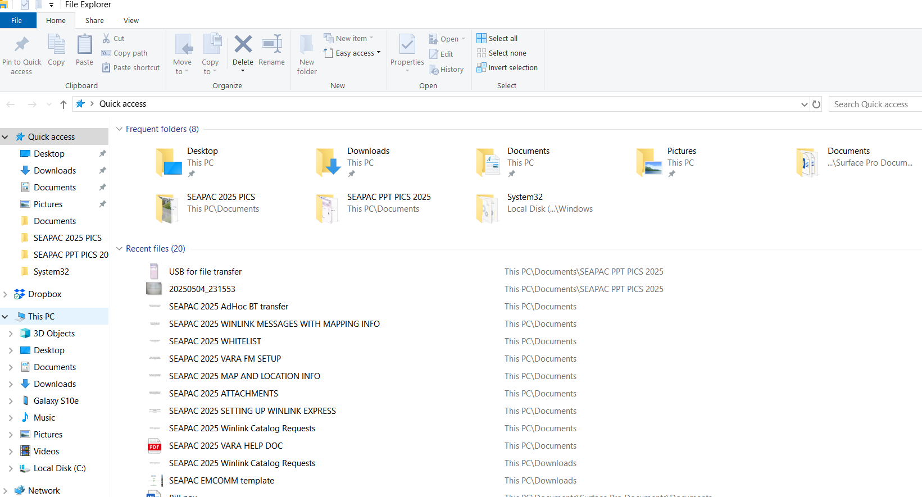
Open File Explorer and select “This PC”

Slide 18
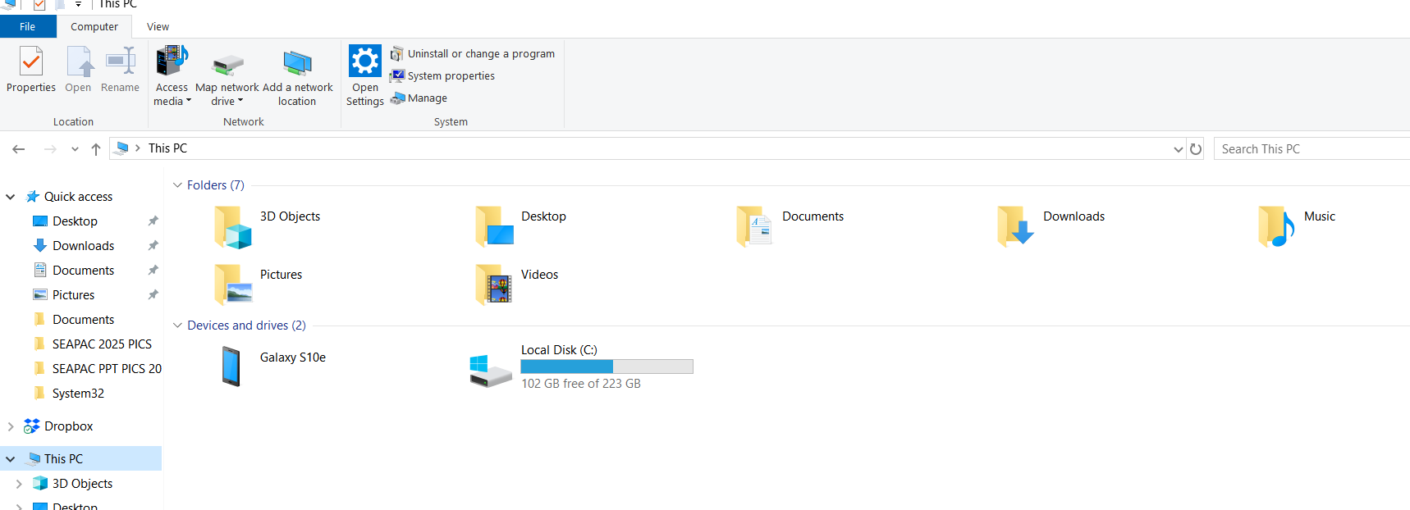
You will then see this screen, note Devices and drives…click on the phone (Galaxy S10e)

Slide 19
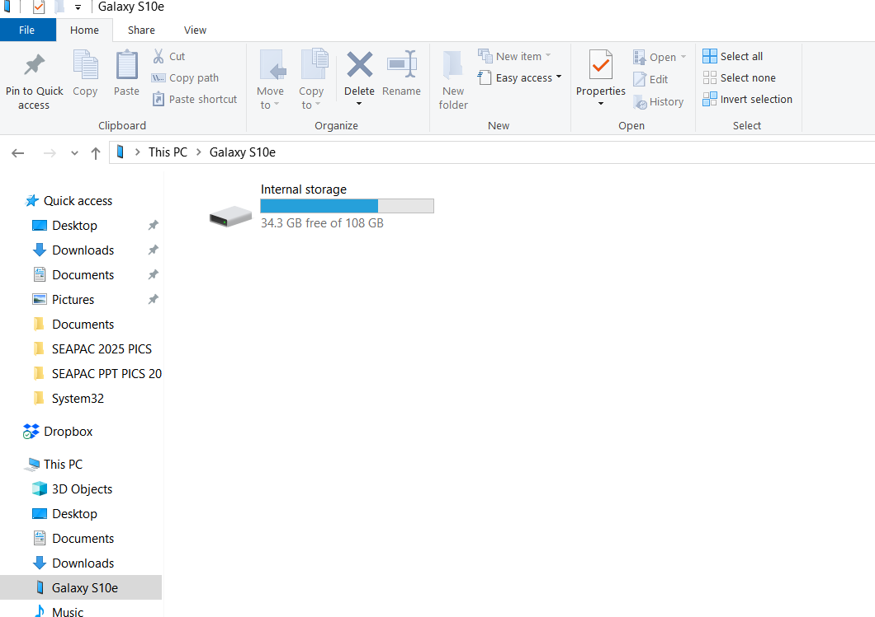

You will now see the Internal storage for phone, click on it

Slide 20
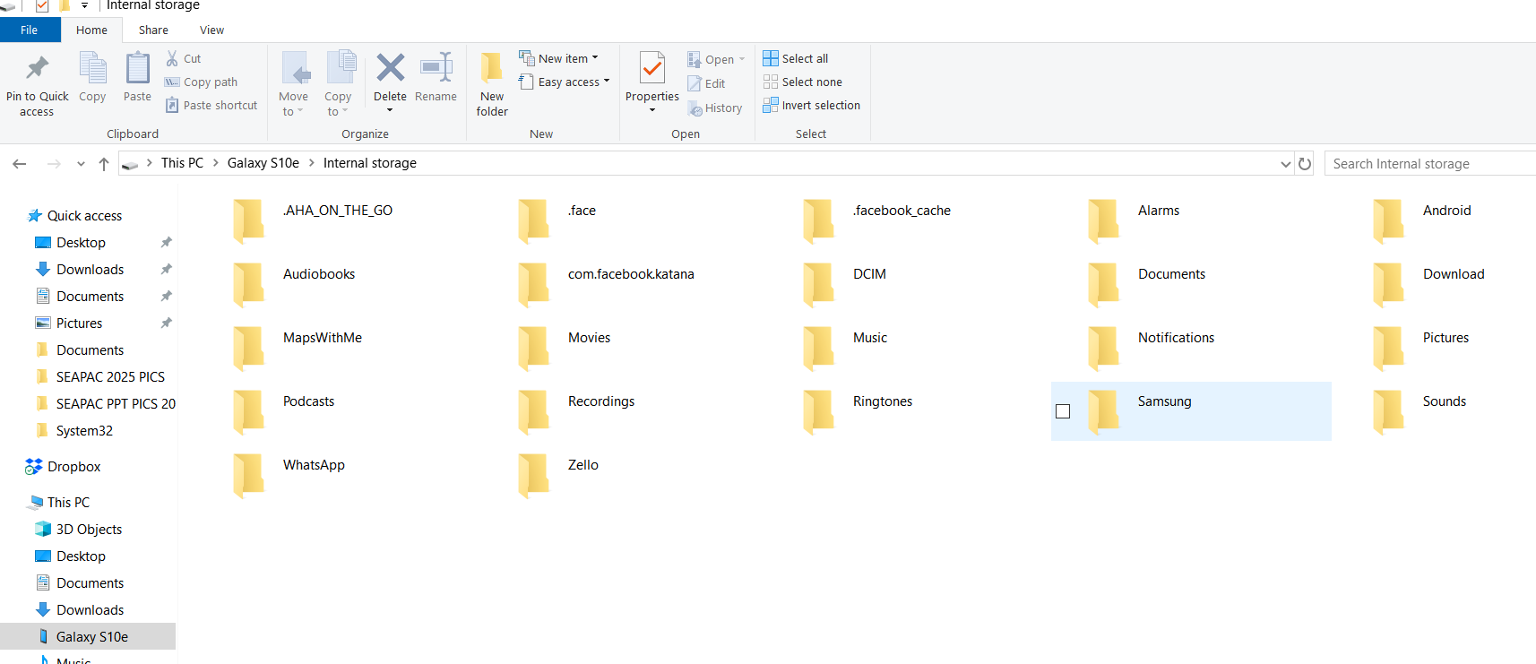

You will see files on the phone, pictures are stored in DCIM, click on it

Slide 21
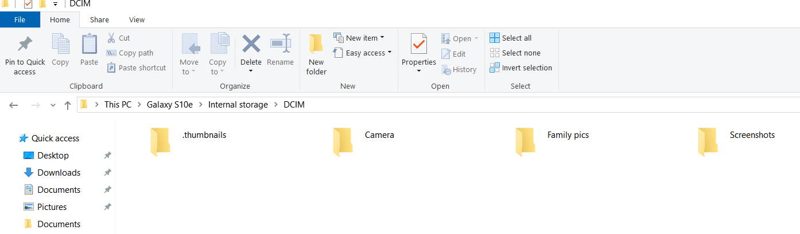

Next click on the file named Camera

Slide 22
The pictures on the phone will start downloading as thumbnails
You will see the pictures begin downloading as tiny pictures/thumbnails
If there is a lot of pics, it will take a moment to download them all
The most recent pics will be at the very end of the download
If not your phone, select the pics you want to send…disconnect the phone and delete non-used pics?

Slide 23
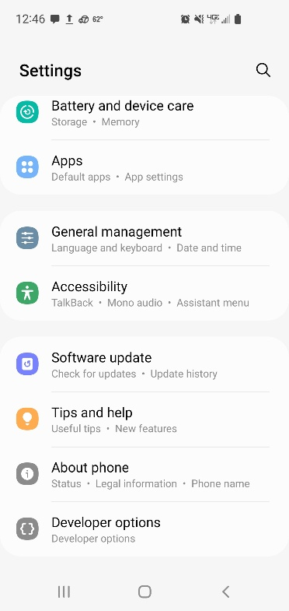
Nerd option… if not working…on your phone, go to settings, scroll all the way down to “About Phone”

Slide 24


Tap on “About Phone” about 5 times and you will then open up a new screen “Developer options”

Slide 25
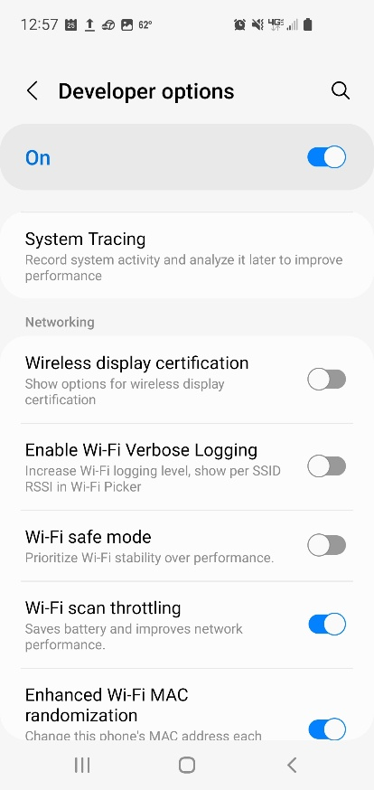
Open up Developer options, scroll past Debugging section, to Networking section

Slide 26
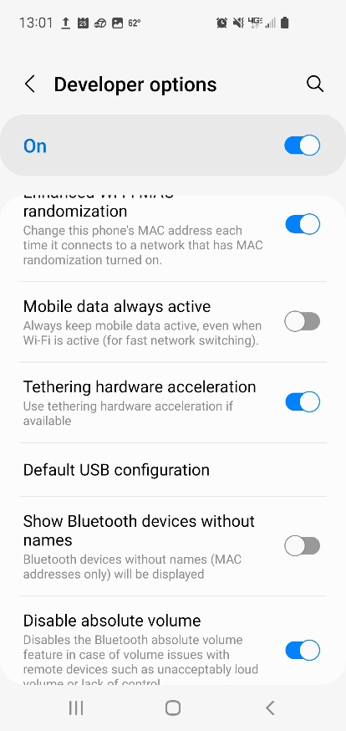
In Networking scroll down to “Default USB configuration”, click on this

Slide 27
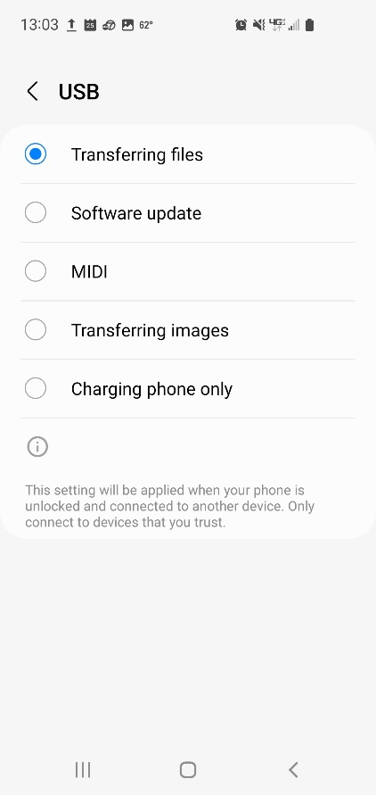
Next screen… make sure the “Transferring files” box is selected…file transfer should work

Slide 28
Being able to transfer files from a phone to your laptop is a valuable skill in the field
This PPT should help with getting an important picture taken by someone else onto your laptop so you can send it where needed most
Be cautious about what you do while in the Developer options section…I am just showing what could be needed if a phone has a picture that must be sent to others
Enjoy and stay safe..

