Slide 1
SETTING UP YOUR WINLINK MAP AND GPS LOCATION
KB7RHI

Slide 2
WI-FI Access

Slide 3
The Winlink program has several mapping features
When using a GPS Location, you will want to first select a map to download and save while you have an internet connection
Lets look at the steps to set up your map choice

Slide 4
Winlink has a built-in mapping feature, you can select which map you want to use…click on the Globe icon

Slide 5
The Winlink program needs a data point first
Winlink program needs a data point first before you can open up a map to display
You need to have at least one Winlink message sent your inbox first
Someone can send a Telnet message to your inbox
Once you have a Winlink message in your inbox…proceed to the next slide

Slide 6
The Winlink Program can download and store a map provider of your choice while you have internet…I would recommend “Google Terrain”

Slide 7
Here are the map provider choices… the default map is Bing

Slide 8
Once you select your map provider, then click on “Display Map”…this will download your map while you have internet…do this before an event

Slide 9
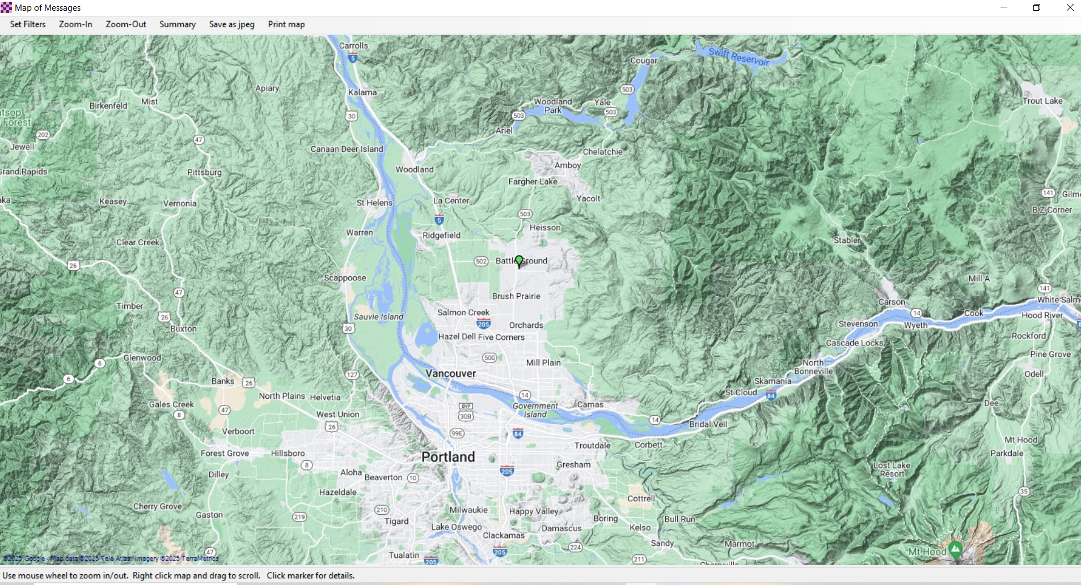

Slide 10
To move the map around, right click and move your mouse

Slide 11
You can Zoom-In with the map by clicking on the Zoom-In tab, or scroll your mouse

Slide 12
Saving your map with the Winlink program
The Winlink program will download the map to the “Display Map” area you select…limited area
Next go into airplane mode with your laptop, open up the map again, and see what area looks well defined?
If you move the map outside of the area downloaded, you will just see a very simple map

Slide 13
The Winlink program can show user location information on a map
The Winlink program has several different types of mapping features
The Winlink program can now embed your location information into messages you send
Other Winlink users can receive an email from you with your location information and open up a map to see where you are
The accuracy of your location depends on one of three location methods being used

Slide 14
Your Winlink email messages will show your location one of three ways
1) If a GPS is present, Winlink will use GPS Lat/Long
2) If no GPS present and “Use position report location…” is checked, Winlink will use Position Report Lat/Long
3) If no GPS is present & “use position report location…” is not checked, Winlink will use Grid Square/Call sign location

Slide 15
1) GPS Location…Open up Winlink Express and go to Settings, then select GPS/Position Reports in the drop down menu

Slide 16
Shortcut to GPS, click on Position Report icon

Slide 17
This screen has two sections…The upper section is the GPS present section with live data strings showing

Slide 18
The lower section is the Position Report section

Slide 19
In the GPS present section, you will want to find and then select the Com Port that your GPS is using, (Baud Rate is usually set at 4800)

Slide 20
Find a Com Port…Right click on the Microsoft Windows icon in the lower left corner of your computer screen, then scroll up and select Device Manager…Windows 10 example

Slide 21
In the Device Manager, scroll down alphabetically to Ports and click on the right arrow to open up and see your active ports

Slide 22
In this example the GPS dongle is on (COM 3)

Slide 23
Using the “GPS Serial Port” drop down menu, just select the COM 3 for your GPS…note, your GPS may require a driver be installed first before the GPS dongle will work?

Slide 24
Your “GPS Status” should show an updating string of information, and GPS Lat and GPS Long boxes should populate with your location info, select “Set” if no data flowing after the dongle has a satellite fix

Slide 25
Once your GPS lat and long box populates with location information, your GPS is present, your Winlink email messages will now show location = (GPS)…when using Winlink for viewing messages

Slide 26
Winlink message sent with GPS Present…Location = (GPS)

Slide 27
2) The lower part of the GPS/Position Report screen shows Lat/Long information that can be manually entered or populated with a GPS dongle

Slide 28
With a GPS present, you can populate your Position Report section using live GPS data by selecting “Use GPS Position”

Slide 29
You can also manually enter Position Report Lat/Long location information…Note that Lat/Long may be DD.DDDD, DD-MM-MMx, or DD-MM-SSx

Slide 30
Using a GPS enabled phone, you can use the Android app HAMGPS
EA4EOZ is a electronic enthusiast who developed the app to provide GPS location information when you have no cell coverage and you are off grid
HAMGPS app uses four constellations of satellites
1) US operated GPS
2) GLONASS…Russian
3) QZSS…Japanese Government system to augment US GPS
4) Galileo…European global satellite system

Slide 31
Android phone HAMGPS Icon

Slide 32
Clicking on the bottom screen section will sequentially walk through different GPS data screens…Grid Square display

Slide 33
GPS DD.DDDD display, this is the screen that is easiest for me to use

Slide 34
If you are camping in a remote area with no cell coverage, WiFi, or internet connection…try HAMGPS, if you do not have a GPS dongle
Camping in a remote location, I used HAMGPS to find my location
I used the DD.DDDD display to enter coordinates
Entered Lat as DD.DDDD N
Entered Long as –DD.DDDD W
Enter your minus in front of the Longitude
Remember to enter the Lat “N” after DD.DDDD “N”
Remember to enter the Long “W” after –DD.DDDD “W”
The Position Report will remove the minus sign in front of Long after it is entered…its ok

Slide 35
DD-MM.MMx display

Slide 36
DD-MM-SSx display

Slide 37
And finally MGRS display, then back to Grid Square, tap the box to rotate to your desired display

Slide 38
Winlink will use Position Report location information if there is no GPS present and you check the “use position report location…” box

Slide 39
When you use the Position Report section to provide your location, your email will say, “Location” is (SPECIFIED)

Slide 40
Winlink message with no GPS present, Position Report box is checked…Location = (SPECIFIED)

Slide 41
If you want to clear the Lat/Long data in your Position Report…with no GPS present, just click on “Use GPS Position”

Slide 42
Lat/Long is cleared, there is some place holding data in MGRS and any Comment is still there

Slide 43
3) Third default position location determination is Grid Square
If there is no GPS present
If the Position Report “use position report location” box is not checked
Your default position location will be the Grid Square location noted in your Settings menu in Winlink

Slide 44
You can double check what grid square location you have set…in the main Winlink screen, go to “Settings”

Slide 45
Select “Winlink Express Setup…”

Slide 46
In the lower left hand side of the screen you will see “My Grid Square”, the grid square information you put in the box, will be what shows up in your messages, only 6 characters used

Slide 47
GRID SQUARE information
When a GRID SQUARE is used, a randomized location within the grid square is created using both the grid square and the call sign
This prevents multiple stations from piling up in the middle of the grid square

Slide 48
Winlink message with no GPS Present & Position Report “use position report location” box is not checked…Location = (GRID SQUARE)

Slide 49
Recommended GPS dongle on Amazon

Slide 50
GPS dongles
There may be less expensive dongles available such as on Amazon
I do not have any experience with other dongles and can not make a recommendation

