Slide 1
VARA FM SET UP USING DRA-50 & DIGIRIG SOUND CARD
KB7RHI

Slide 2
What is VARA?
VARA is a software program that serves as a sound card TNC for use with your radio
Jose Alberto Nieto Ros EA5HVK developed this program which brings military grade technology to the digital radio community
VARA is a game changer for the digital radio community
Two popular Winlink versions are VARA FM and VARA HF
Will be sharing information about VARA FM today

Slide 3
VARA FM versus 1200 baud packet for sending messages
Regular Winlink 1200 baud packet sends data in packet frames, if there is just one bit error in a frame, the entire data frame needs to be resent
VARA FM uses FEC Forward Error Correction and can correct minor bit errors on the fly by sending redundant data

Slide 4
VARA FM VERSUS 1200 BAUD PACKET
Vara FM is rate adaptive, meaning it adjusts to the strength of the signal
VARA FM can adjust the signal rate if experiencing weak signal conditions
1200 baud packet is not rate adaptive and does not do rate adjustments

Slide 5
VARA FM versus 1200 baud packet
VARA FM program has data compression which allows the message to be sent faster
1200 baud packet does not have data compression

Slide 6
VARA FM is a fast digital mode (relative to 1200 baud packet radio) that works well for sending images using your FM radio
VARA FM WIDE has 13 speed levels, you need an FM radio with a data port capable of 9600 baud packet operation…that provides a 6Khz bandwidth, with a speed up to 25,210 bps
How fast is 25,210 bps? You can send a 100KB picture across your county in about 1.5 minutes…depending on terrain and distance

Slide 7
VARA FM Narrow
If using a microphone and speaker connection for digital radio, you will be limited to VARA FM NARROW with speeds up to 12,750 bps, because bandwidth is now limited to 3Khz
You will need to select 1200 baud packet in your radio menu

Slide 8
VARA FM NARROW is still much faster than regular 1200 baud packet radio
VARA FM NARROW has 11 speed levels
VARA FM can be used with a regular 1200 baud Winlink RMS station to accept both 1200 baud packet and VARA FM NARROW connections
VARA FM NARROW can use regular voice repeaters without a squelch tail or with some crossband repeaters (at somewhat slower speeds)
Yaesu FTM-400 in crossband works ok, was unable to get my FTM-300 and FTM-150 to work with VARA FM NARROW

Slide 9
VARA FM WIDE requires a one-time license
The one-time license fee costs $69
It is good for both VARA FM and VARA HF
NOTE: If you already own an ICOM 7300 HF radio, that radio has a built in sound card and with the VARA license, you can start using VARA HF right away to send email at nearly Pactor 3 speeds, no sound card needed ☺

Slide 10
What happens if I do not buy a VARA license?
Without a VARA license, you will be limited to the following: (You will not be a happy camper)
1) Compression is turned off
2) Speed is limited to level 2 (1,188 bps)
3) You can not be a Digipeater or use a Digipeater
4) You will see a perpetual nag screen to purchase the license

Slide 11
Lets see what you can do with a VARA license…demonstrations today
1) Show the station view when sending out an email message with a picture
2) Show the station view when receiving a picture
3) Show connecting to a VARA FM Gateway

Slide 12
More demonstrations today
4) Will show how to do an Auto Tune with a P2P station…(same method used when using an RMS Gateway) later in this PPT
5) Will show how to PING a nearby station to check pathway quality later in this PPT

Slide 13
Clark County, WA simulation
6) Simulate an earthquake has just happened and there are several radio team members in your county who have stood up their portable VARA FM station. A voice net has been set up at a command post and a request has gone out to please send in pictures of significant damage…(A picture is worth a thousand words)…in this scenario, your Clark County ARES/RACES team is responding to the request

Slide 14
Grid down and networks down, set up one Starlink site in your county
With one Starlink site set up, you can relay regular email messages into and out of your county
Couple the Starlink to a Winlink VARA FM WIDE RMS Gateway, add any needed Digipeaters to expand coverage, and you have a powerful comms capability
Have the Winlink RMS Gateway use a higher gain Omni antenna up on a mast for best area coverage

Slide 15
Steps to take to download your VARA program software
Go to the Winlink.org website first

Slide 16
Click on “Download”

Slide 17
Winlink downloads has the software for the VARA programs

Slide 18
Download VARA FM and follow the installation steps

Slide 19
Let’s see how to set up your VARA FM station
You have a Winlink station and registered call sign already
You have purchased a VARA license
You are ready to setup your VARA FM station

Slide 20
Setting up VARA FM for your station
Most FM mobile radios with a data port capable of 9600 baud packet will work
In the radio menu, set the packet rate to 9600 baud, have radio APRS turned off
Connect the cable that goes from your radio to the modem, turn on your radio…in this example I will be showing a DRA-50M ordered from masterscommunications.com
Connect the modem to the laptop, this provides power to the modem
You are now ready to set your audio input and drive levels to optimize your VARA FM station

Slide 21
In the Open Session box, use the drop down menu to select “Vara FM Winlink”

Slide 22
This is the Vara FM Winlink Session screen, next click on “Settings”

Slide 23
Click on “Vara TNC Setup”

Slide 24
You will see the Vara FM Setup screen, check the “Automatically launch Vara FM…”box, and the “Show Vara FM TNC screen when it’s launched” box, click on “Update”

Slide 25
If the VARA FM program did not open up, close the VARA FM session and try again now that you have checked the boxes to automatically open

Slide 26
Soundcard Shortcut
Right click on laptop desktop
Select “New”, then “Shortcut”
This shortcut is needed to check your computer sound card settings each time you operate VARA FM
You will do an initial setup and then need to double check if any changes are needed with each VARA FM session you do

Slide 27
Soundcard shortcut…Right click on your computer desktop, select New, Select Shortcut

Slide 28
In the “Type the location of the item:” box, enter “control mmsys.cpl”

Slide 29
You entered control mmsys.cpl, now click on Next

Slide 30
Now enter the name you want for this Shortcut…I use Sound Cards

Slide 31
Click on Finish, you now have a Shortcut for adjusting settings for the VARA Program

Slide 32
Configuring your computer sound card settings
You need to configure your computer sound card settings so the VARA FM program is the only device using the your external sound card
These settings need to be rechecked each time you start up your computer, the computer tends to change them, and you put any changes back in order

Slide 33
Open up the Sound Cards shortcut

Slide 34
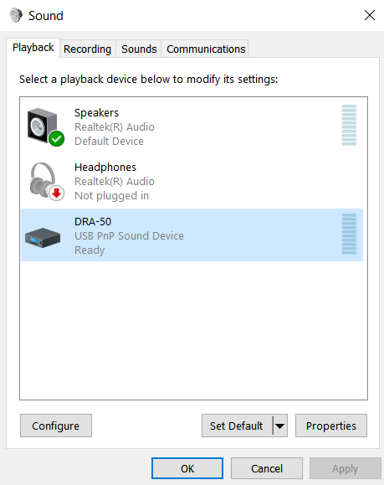
Playback tab, select and click on USB PnP Sound Device

Slide 35
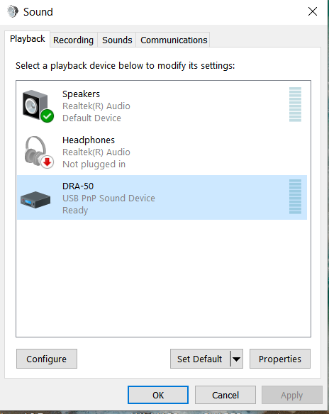
If the Green circle (Default icon) is on your sound card, highlight speakers, then click “Set Default” button in the lower section

Slide 36
The Windows computer sounds will be sent to the sound device with the Green circle with a check mark inside it
You do not want computer sounds interferring during a radio transmission
Look to see if your sound card has the Green circle default icon, if so, change it to another sound device

Slide 37
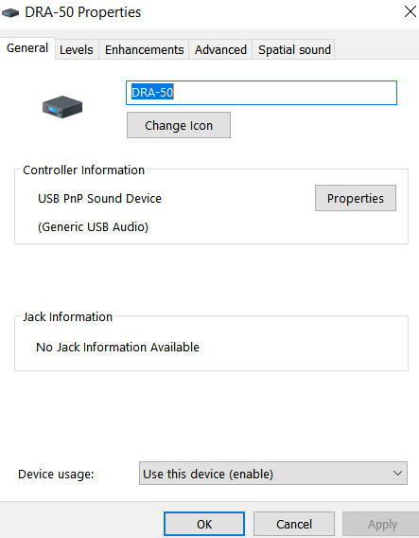
PLAYBACK “General” tab, you can change name and icon of your modem

Slide 38
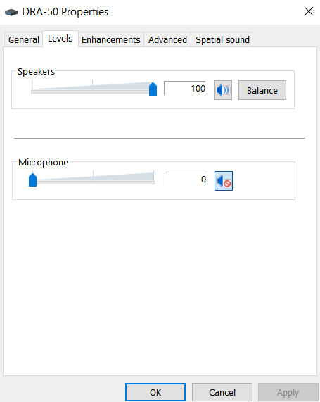
PLAYBACK Levels tab, set “Speakers” to 100% and “Microphone” to zero, (Drive Level Settings)

Slide 39
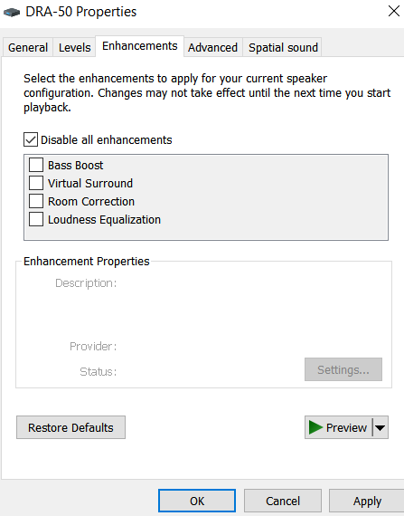
PLAYBACK Enhancements tab…check “Disable all enhancements” box

Slide 40
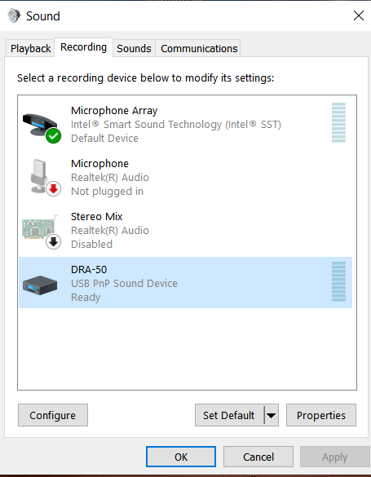
Go to Recording tab, then select and click on USB PnP Sound Device (Audio input level)

Slide 41
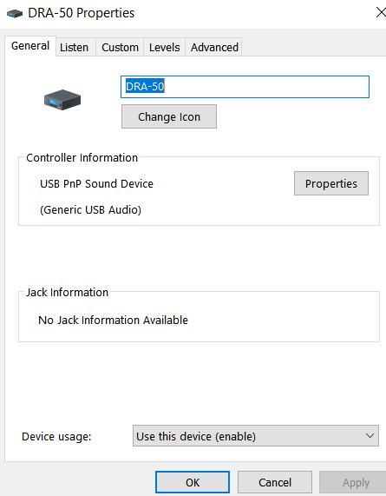
Recording General tab, you can change name and icon of your modem

Slide 42
Recording Custom tab, uncheck AGC box

Slide 43
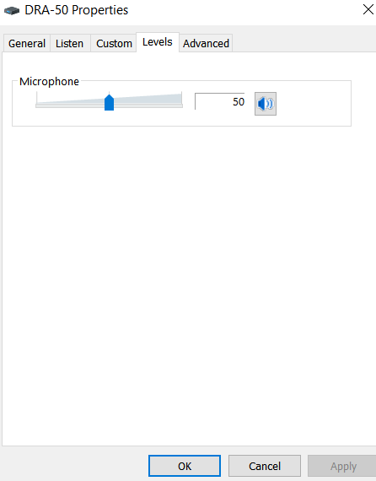
Recording levels tab, set microphone to 50%, may adjust later as needed

Slide 44
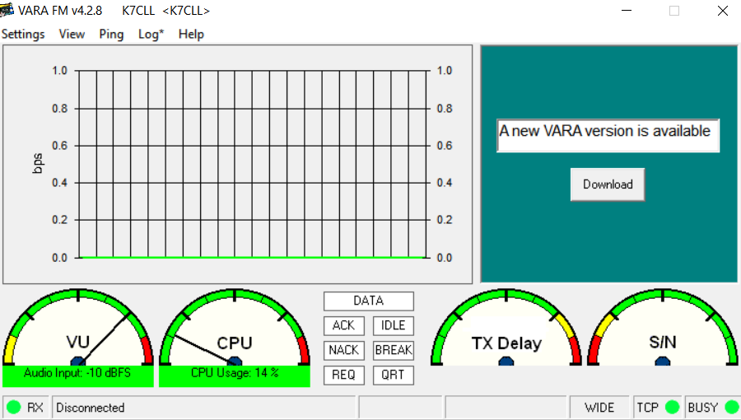
Open up VARA FM program, go to upper left and select “Settings”, “VARA Setup…”

Slide 45
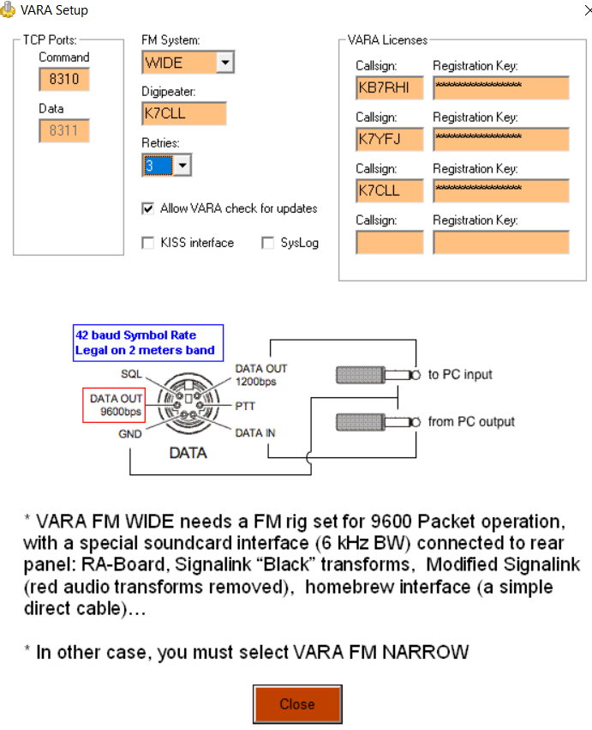
FM System:…Select “WIDE”, VARA Licenses…Enter licensed “Callsign” and “Registration Key”, Digipeater: Call sign must be a licensed call sign, can be different from current Winlink program call sign being used

Slide 46
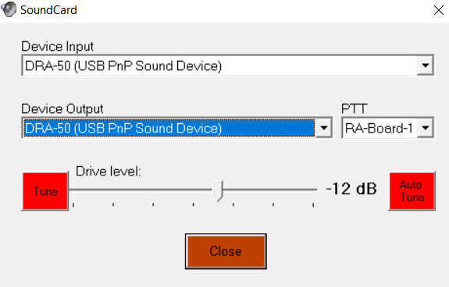
Next go to “Settings” again and select “SoundCard..”, you will want to see “Device Input” and “Device Output” showing (USB PnP Sound Device)

Slide 47
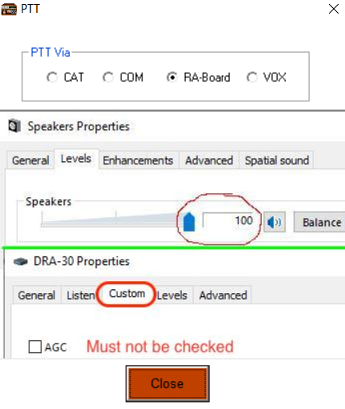
Next go to “Settings”, select “PTT…”, with a DRA-50, select RA-Board, with a Digirig…select “COM” for com port, select the correct COM Port

Slide 48
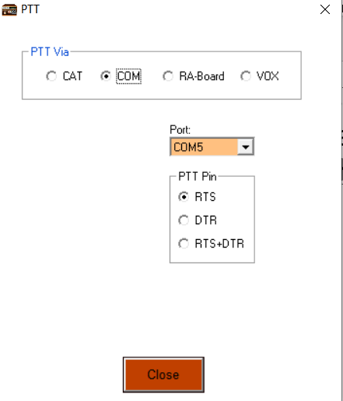
Select the DigiRig mobile COM port and select RTS, then Close

Slide 49
The VARA FM program needs two audio level adjustments, audio input level (manual) and audio drive level (automatic)

Slide 50
Manual audio input level is adjusted first, lower left screen shows “VU”, “Audio Input” meter, we want to adjust the meter to about “-11 dBFS”

Slide 51
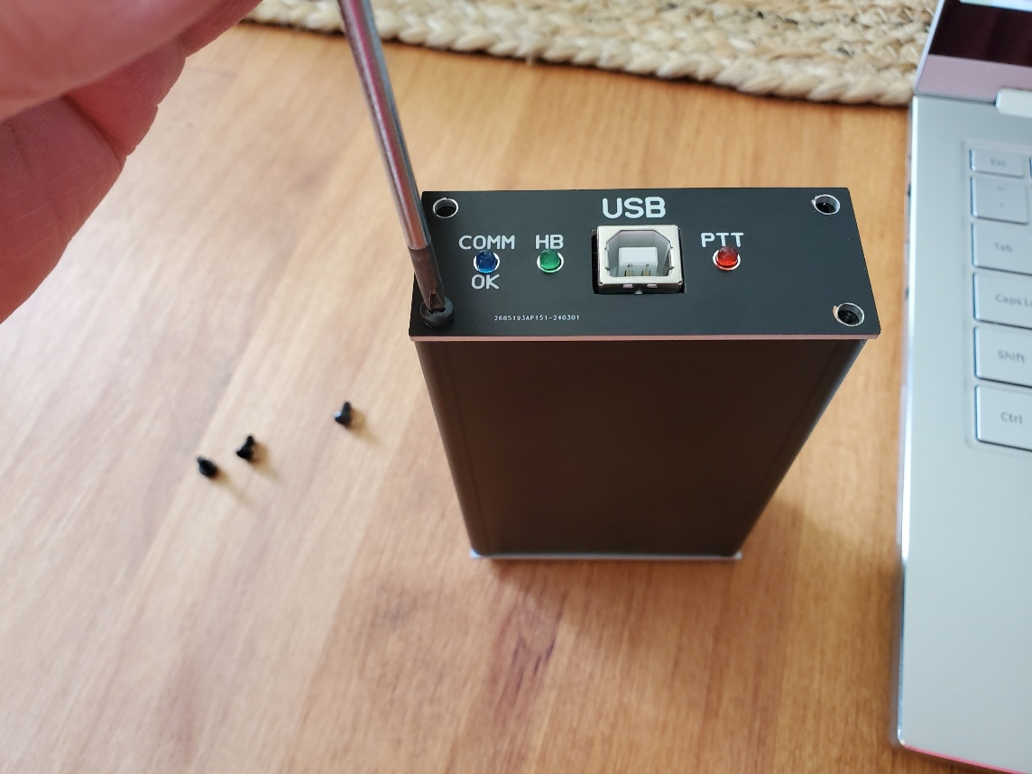
To adjust the audio input, remove the DRA-50 board from the case by removing the four face plate screws, then push on the back end enough to then pull the board out

Slide 52
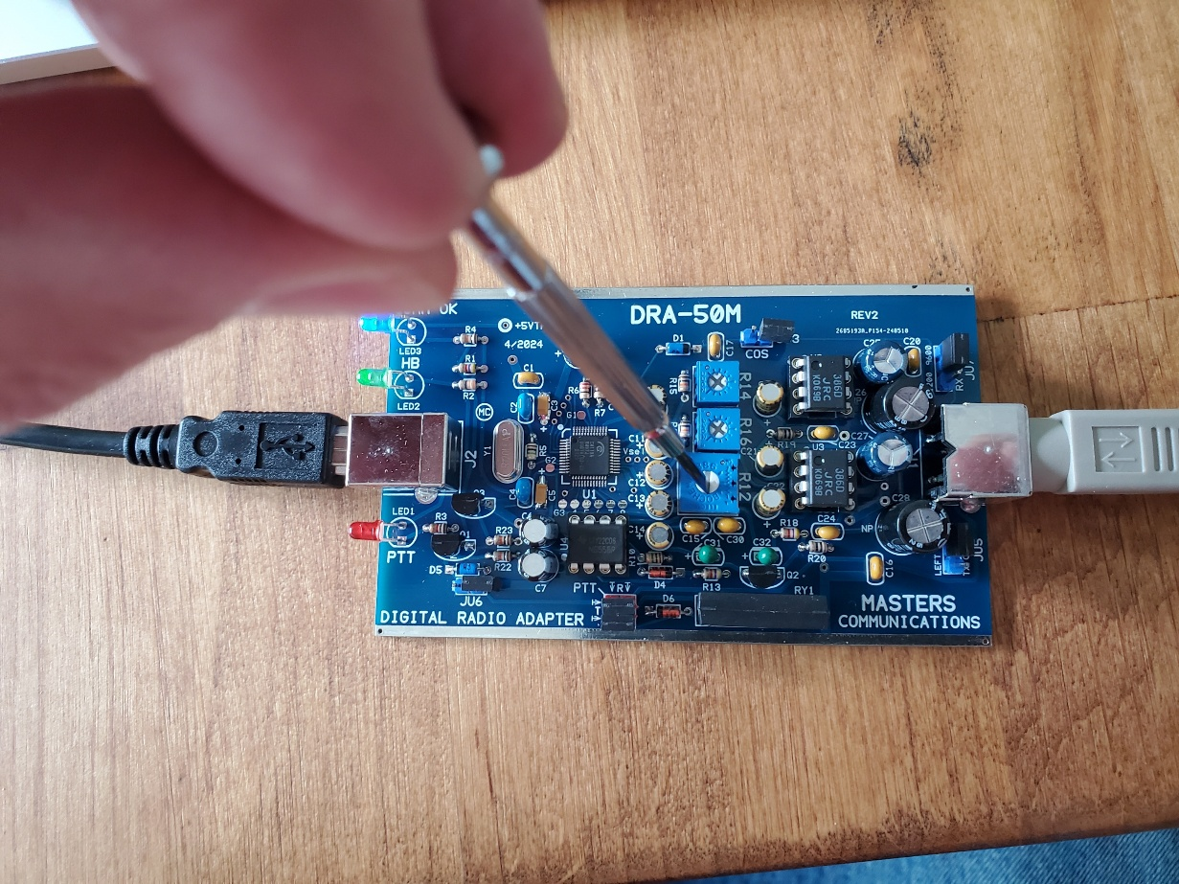
Have your DRA-50 hooked back up to a radio that is on and laptop, gently turn the larger blue trim pot with a flat headed screwdriver till the VU meter shows about -11 dBFS

Slide 53
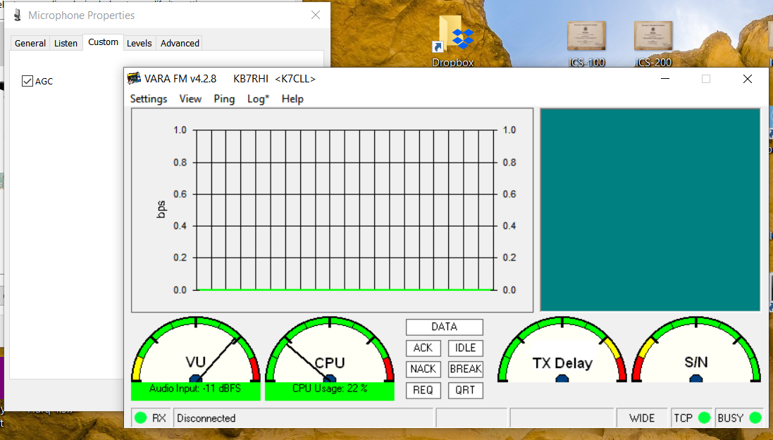
AGC was on by default when I started up my laptop…I had opened up the DRA-50 and adjusted VU level to -11 without knowing AGC was checked

Slide 54
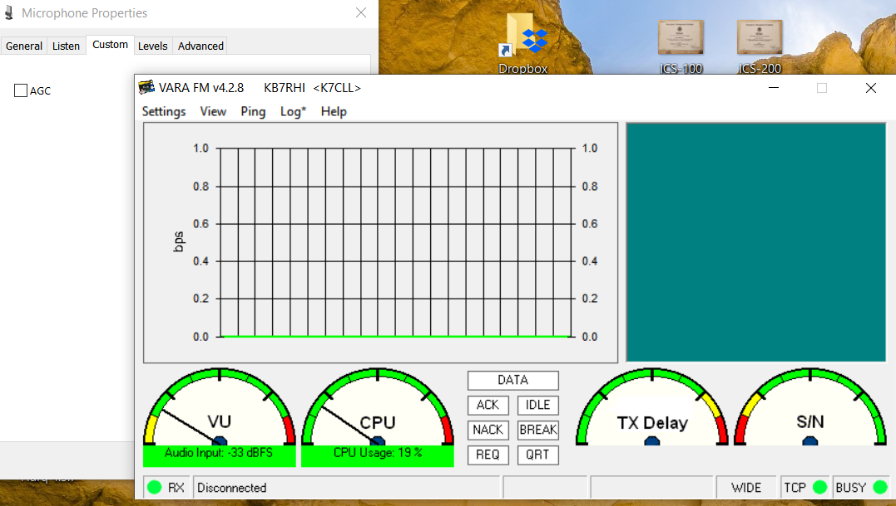
Unchecked my AGC box and the VU levels fell down to -33…note to self…double check all your sound card settings first before opening up the DRA-50 to readjust

Slide 55
DRA-50 minor audio input level adjustment after first doing a DRA-50 trim pot adjustment
After you have taken the DRA-50 board out and done a VU meter adjustment to -11, at a later time you find the VU meter is a little higher or lower than what you want
You probably do not need to open up the DRA-50
Just go back to the laptop soundcard Recording levels tab and left click your mouse on the slider to adjust the level back to -11, that is why on the first adjustment you set at 50%, to give you some wiggle room

Slide 56
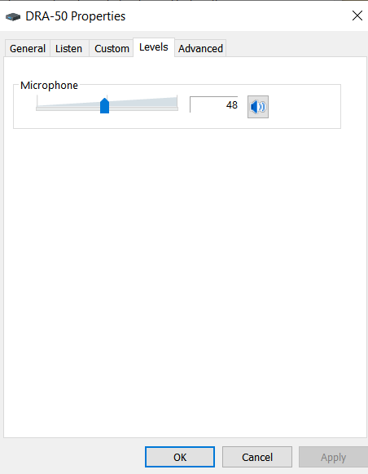
A DIGIRIG does not have an audio input trim pot to adjust, adjustment is done with the laptop Recording levels tab to get VU meter to about -11

Slide 57
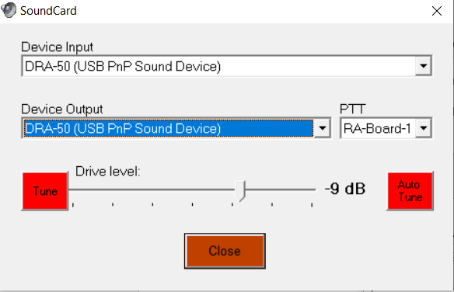
Automatic drive level adjustment, go back to VARA program “Settings”, then select “SoundCard”, then push on the red Auto Tune button

Slide 58
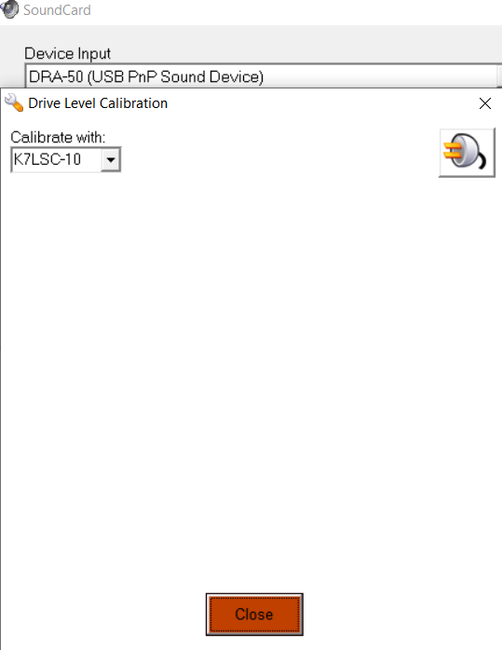
Under “Calibrate with:”, enter the station call sign or gateway call sign, then click on the power plug on the right side of the screen, your station will now send 10 tones to the other station

Slide 59
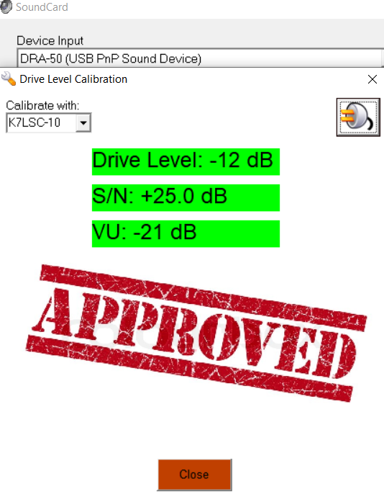
Your station just sent 10 tones, each a little stronger, the receiving station will reply back noting the best tone, your program will then automatically adjust your drive level (Very nice) or give further instructions

Slide 60
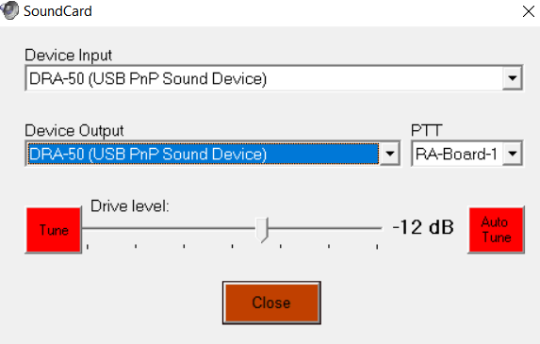
The SoundCard drive level here is -12dB, (You can left click your mouse on the drive level slider to manually adjust the drive level)

Slide 61
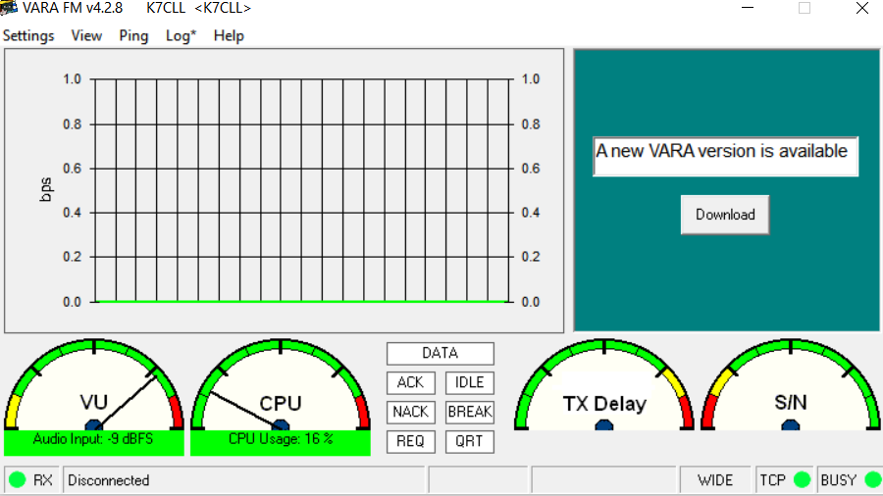
You can do a pathway quality check to another station using the “Ping” feature, with the VARA FM program open, go to “Ping”

Slide 62
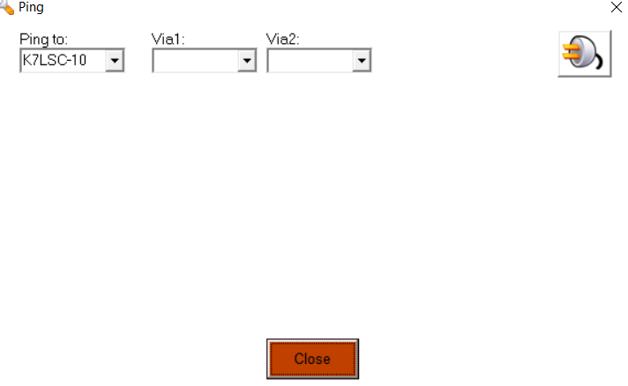
You can Ping a station to see (S/N) and (VU) levels with your radio path, select the station/gateway call sign and any DIGIs, then click on the power plug

Slide 63
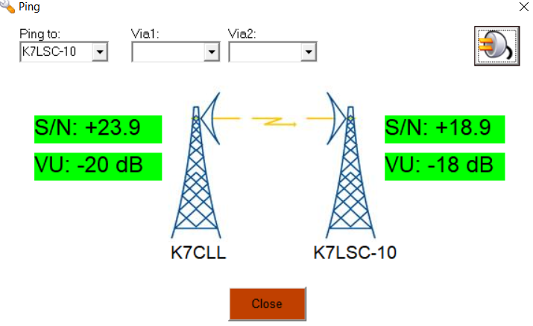
I Pinged the Legacy Salmon Creek RMS (K7LSC-10) from my house, it will not say “Approved”, just shows you the numbers for each station, numbers in green are good

Slide 64
USB Hub issues with RF interference?
Watch out for RF interference if you are using a USB Hub
Using two different USB Hubs, one would lock up my station every time while using a mag mount on a cookie sheet nearby and 5 watts
The other USB Hub would intermittently lock up my station
Problems noted where the radio would lock up on transmit
The Winlink program would freeze up while trying to do a session

Slide 65
What if there is no VARA FM stations in my county yet, how do I calibrate the first station?
Plan to get two VARA FM stations with a VARA FM license
Do the initial setup on your laptop soundcard Playback and Recording levels, then do the audio input level adjustment to VU -11
Drive level setup…With STATION A, do an auto tune to STATION B…STATION B will hear the best tone and report that back to STATION A, and the VARA FM program will automatically adjust the drive level

Slide 66
Setting up your first county VARA FM station
4) Listen carefully to the tones being sent, if they sound over driven, know that the auto tune function can be fooled into trying to select the best of 10 badly distorted tones, in that case, manually adjust the drive level and try again
5) Repeat the steps with STATION B…STATION B will now do an auto tune with STATION A, the best tone will be reported back to STATION B, listen carefully to the tones being sent again

Slide 67
The VARA FM program does several functions independent of your Winlink Express program
When doing a Ping or Auto Tune between VARA FM stations, only the VARA FM program needs to be open
If your station is just a DIGI station, no Winlink Express program needs to be open
The DIGI call sign can be different from an opened Winlink VARA FM session, you just need the DIGI call sign registration key to entered in the VARA program setup page

Slide 68
A note of caution if using VARA FM to send large messages that may include file attachments
If using a handheld radio and VARA FM to send file attachments…be careful not to try sending too large of a file…handhelds do not have active cooling and some modes like VARA FM will heat up your radio more than you might realize
Scott Currie NS7C has reported people with Baofeng handheld radios have burned up their radio while trying to send a large file with VARA FM, there is no temperature protection shut down
It is best to use a radio with active cooling (Fan) with larger file attachments
Mobile radios without active cooling need to be careful…use low power

