Slide 1
Winlink Messages with mapping information
KB7RHI

Slide 2
The Winlink program embeds location information in all your messages
If Two Winlink stations are unsure of where the other station is…a message can be sent with a return request, when the message is sent back, both stations will see the other station’s location as a part of their received message…(this is one method)
If you know your exact location, but are unsure of a field station’s location…have them send you a simple message and you can get their location information embedded in the message

Slide 3
Two major benefits of have a return receipt request in your messages
1) You can know that a message sent out, did make it to the recipient ok
2) By sending a message with the return receipt, both you and the other station can each have the others location information

Slide 4
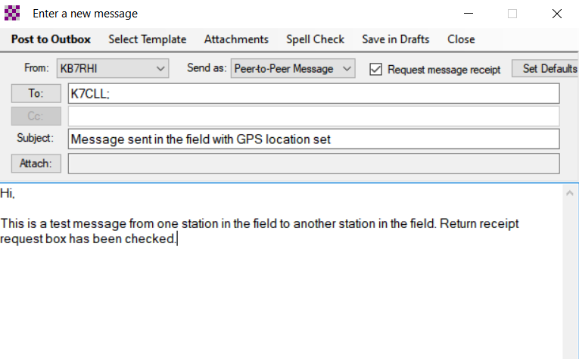

Message from KB7RHI to K7CLL with GPS dongle in use, select the “Request message receipt” box when making out your message

Slide 5
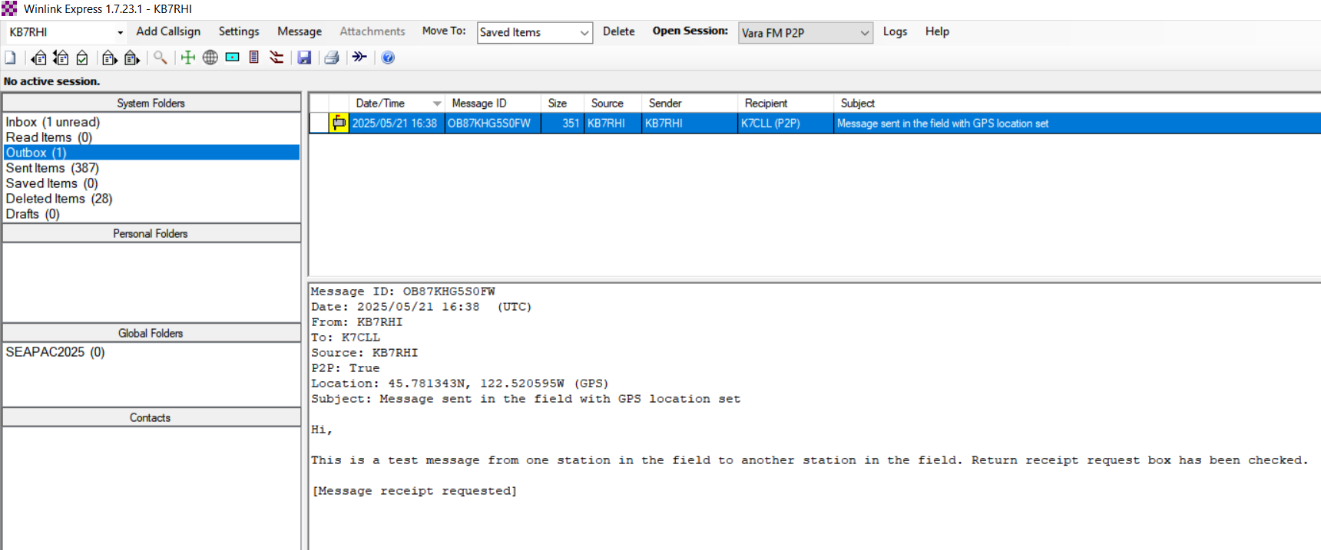

Post the message to the Outbox, in the Outbox…note the selected message Location says (GPS), Recipient says K7CLL (P2P)

Slide 6
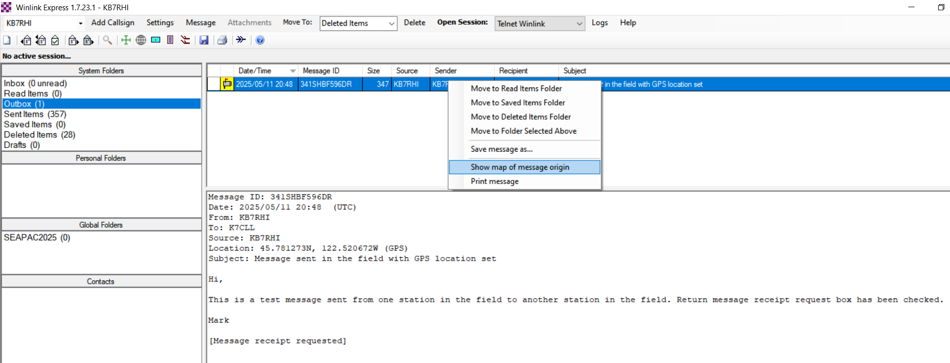
Just right click on your message and select “Show map of message origin”

Slide 7
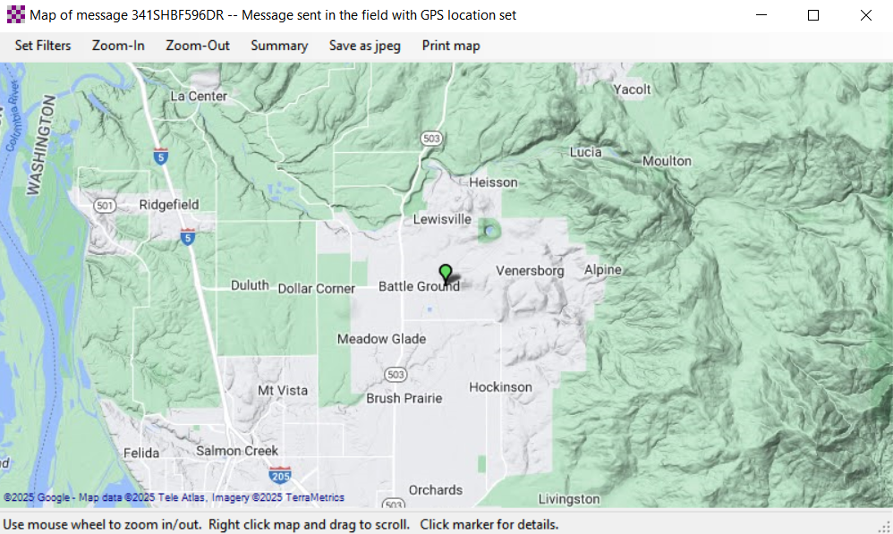
Here is the map location others can see…did not zoom-in with this view…you are the Green bubble

Slide 8
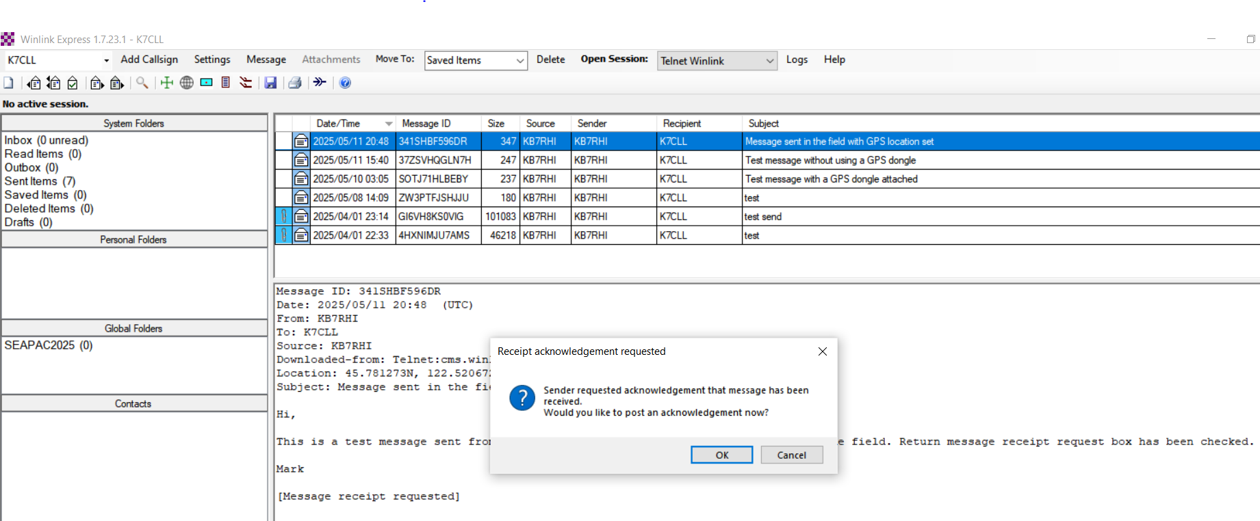

When the Winlink field station has received and selected your message (in their Inbox), they will see this pop up

Slide 9
Acknowledgement info
When you say Ok to a pop up return receipt request, the Winlink program automatically populates your Outbox with the return receipt message information…you do not have to do a “Post to Outbox” step

Slide 10
Acknowledgement request pop up
It is HIGHLY recommended you say YES to return receipt pop up requests!

Slide 11
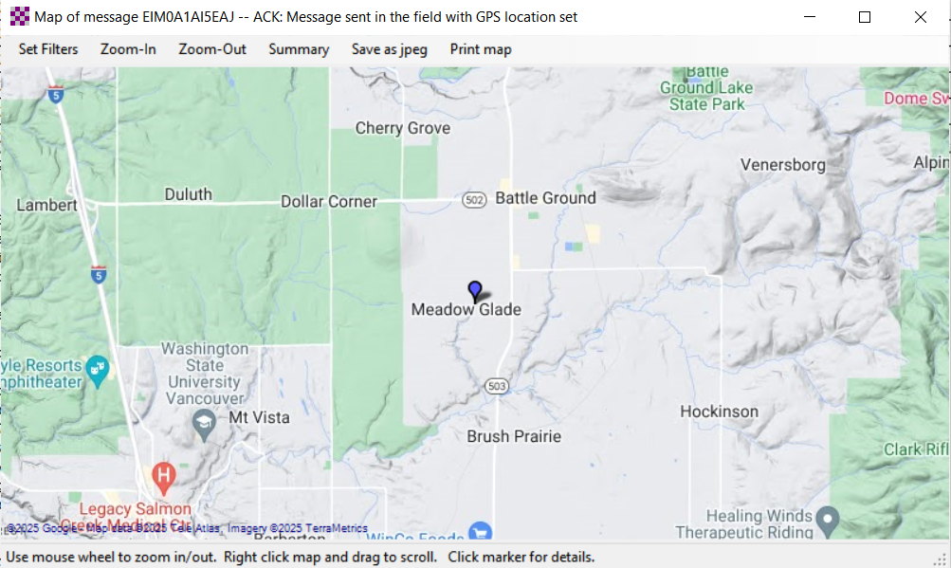
K7CLL Winlink station automatically posted the reply message in the Outbox addressed back to KB7RHI, K7CLL right clicked on the message and selected “Show map of message origin” view

Slide 12
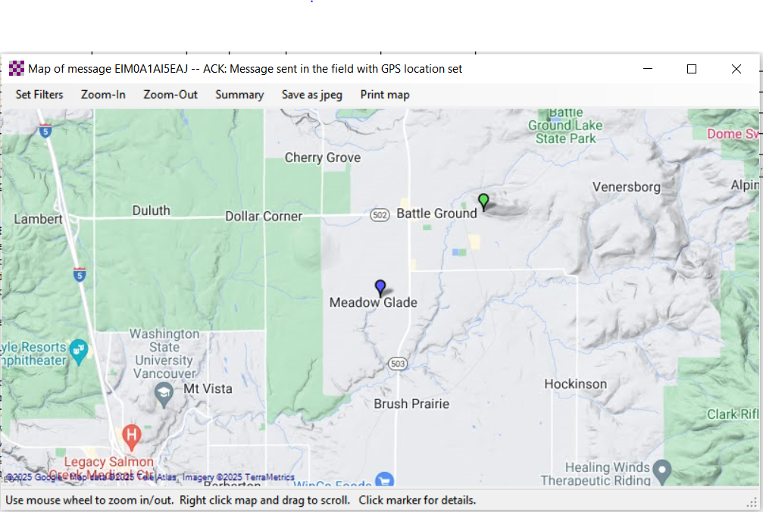
KB7RHI’s Inbox now has received the return receipt message, and right clicked to see map

Slide 13
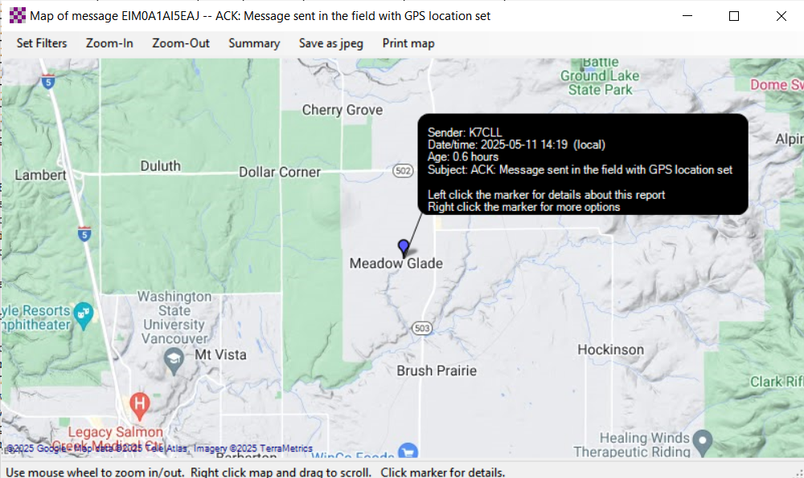
Hover with your mouse over the field station (Blue) and this is the information you will see

Slide 14
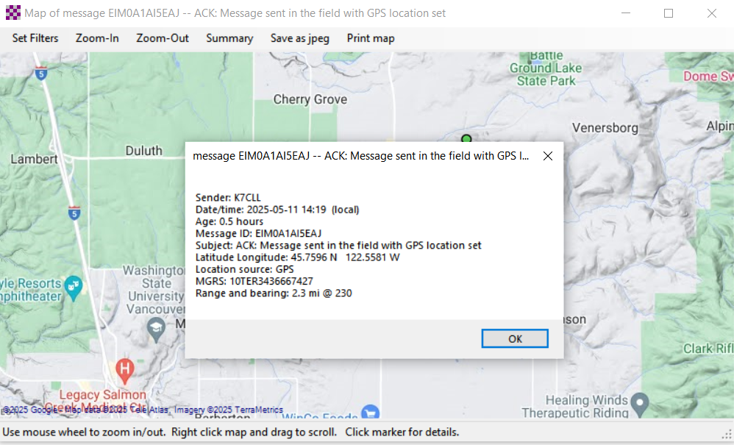
Left click on the field station and it shows Range of 2.3 miles and bearing @ 230 degrees from your station, plus GPS Lat and Long info, LZ info?

Slide 15
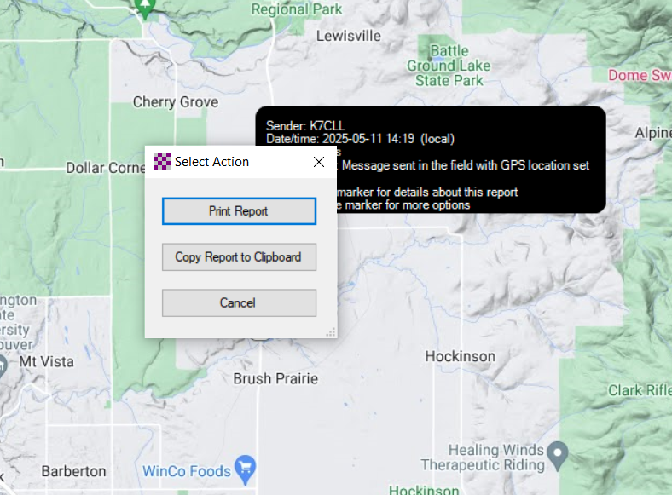
Right click on the field station and this is the information you will see

Slide 16
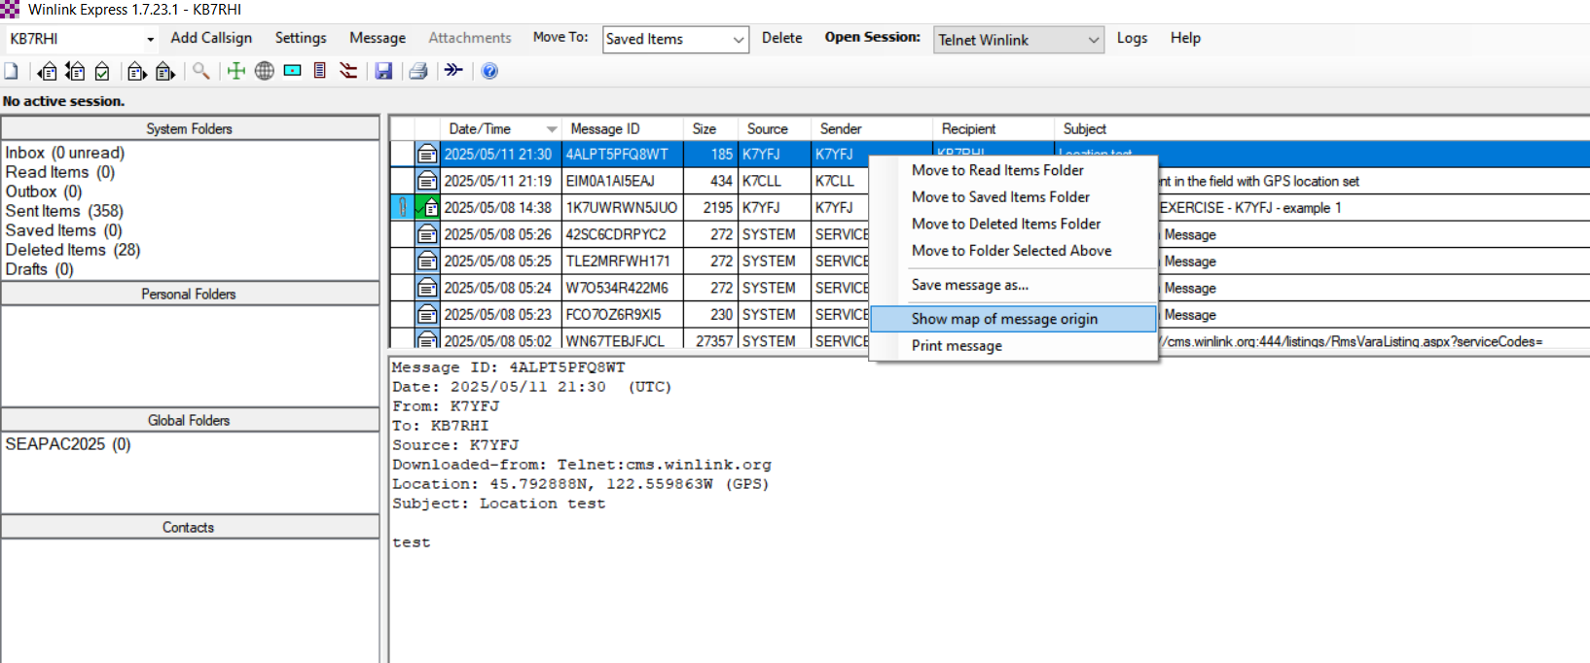

You know exactly where you are, and just need to know the exact location of a field station…they have Lat/Long location and sent you a message, here is their message in your Inbox

Slide 17
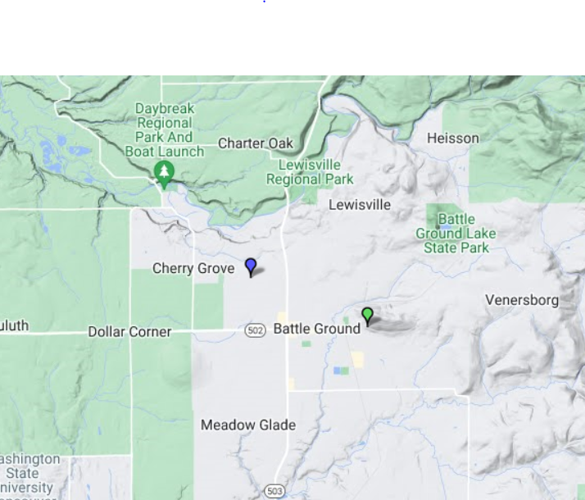
You opened up the map information from their message…KYFJ7 (Blue) just sent you(Green) a short message, you will now be able to see their Range, Bearing and Lat Long information

Slide 18
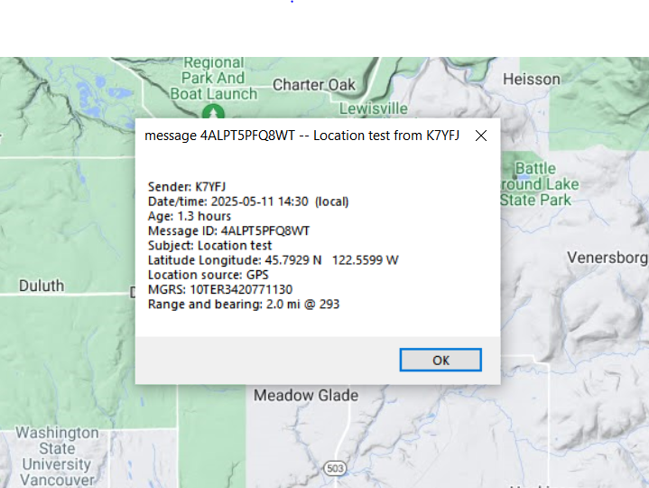
Just left click on the K7YFJ(Blue) bubble and you will now see Range, Bearing, Lat & Long

Slide 19
Return receipt from outside of the Winlink system…You might be trying to reach someone outside the impact zone/area
You might be sending a message out of the area that 1st goes by a radio hop to an RMS station, then by internet the rest of way to a global email recipient( did the message dead end here?)
The recipient can then reply by internet and the message goes back to an RMS station, you do a “last mile” radio hop to the RMS station to poll the RMS and pick up the message

Slide 20
Return receipt request message handling
You send a message with a return receipt
Keep in mind that with these messages there will not be an instant reply, the other station needs to get the message and read it first
Global email recipients will reply back to your message or send a short reply message to your winlink.org address
Winlink system recipients will need to say Ok to the pop up, then send the automatic reply message in their Outbox back to you
If the message was a Winlink message, you will need to poll the Winlink system for your messages

Slide 21
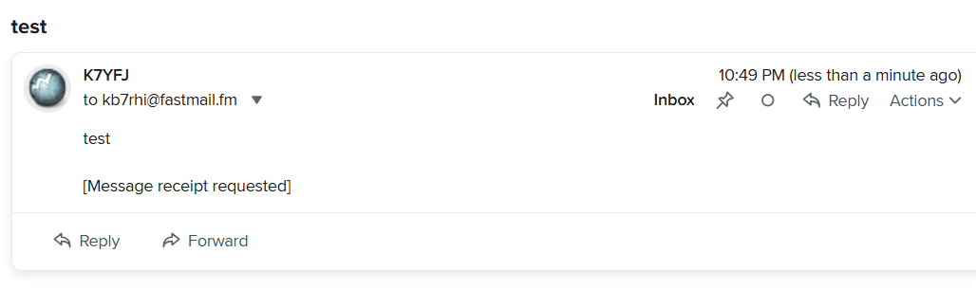
Your return receipt request sent outside of Winlink to a global internet email recipient may look like this, if they click on the down arrow…

Slide 22
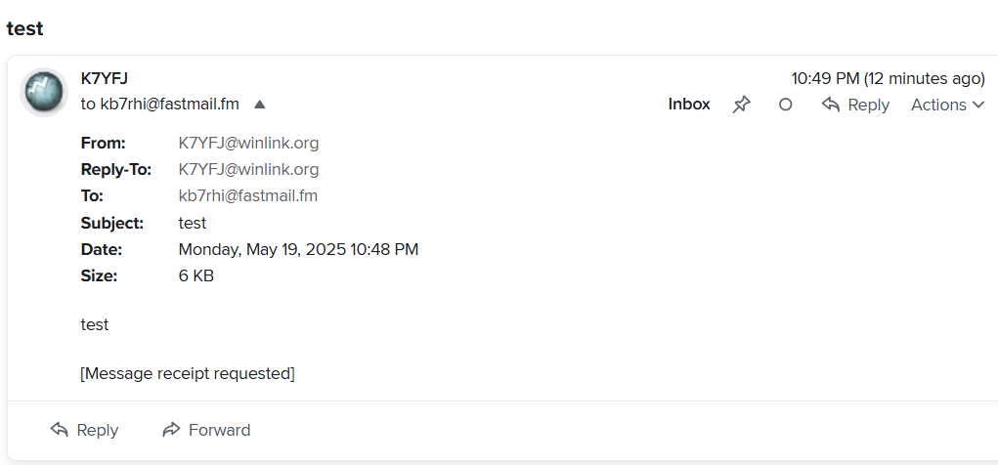

After clicking on the down arrow, they can see this info, instead of just the sender being K7YFJ

Slide 23
The [Message receipt requested] may not be clear enough for what you are asking?

Slide 24
SUGGESTION: Add…”Please send a short reply message back to me indicating you received this email OK to my K7YFJ@winlink.org email address”

Slide 25
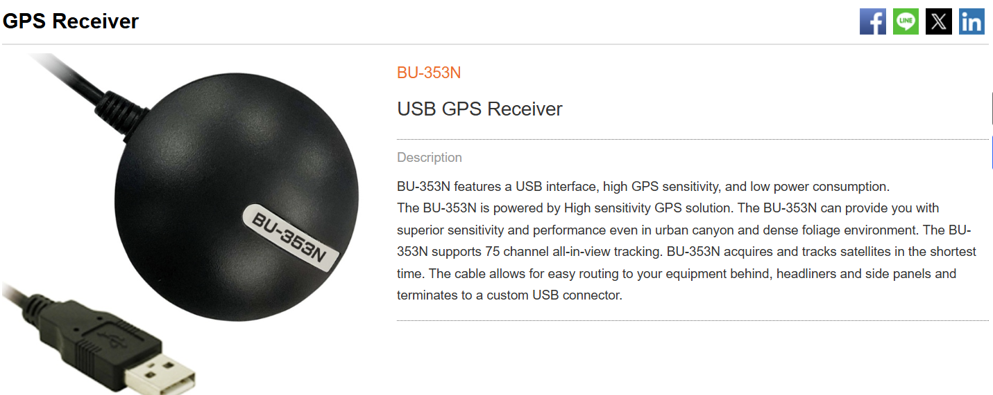
Recommended GPS dongle used by a number of stations made by GlobalSat

Slide 26
There are a number of USB powered GPS dongles on the market that are cheaper
Amazon has a number of GPS dongles
I am just showing one made by a company that makes quality units and they have made GPS dongles for years
Wavetalkers online Winlink support videos show some cheaper dongles
I do not feel comfortable recommending something I have no experience with ☺

Slide 27
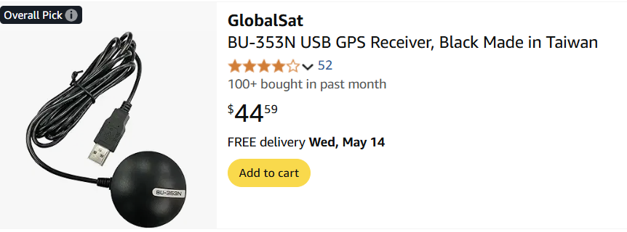
Here is an Amazon price, some Amazon vendors are charging almost double this price…(I have no relationship with Amazon)

