Slide 1
Starlink Supporting Winlink
Carter davis, KH6FV
Honolulu, HI

Slide 2
Starlink is just another ISP
Starlink will supply satellite access to Telnet
Telnet, an acronym for “Teletype Network,” is a network protocol used on the Internet or local area networks. It provides a bidirectional interactive text-oriented communication facility using a virtual terminal connection
It’s simple but unsecure, perfect for Winlink

Slide 3
Current Starlink Status
Multiple versions of Starlink satellites, including v0.9, v1.0, v1.5, and V2 mini, now launching a larger V2 satellite (some call it V3)
Capable of terabyte speeds and throughput along with direct to cellular connections
Optical mesh networking between satellites
As of May 10, 2025, there are 7,135 Starlink satellites in orbit, with 7,105 of them operational, 1146 deorbited
12,000 planned satellites, potentially expanding to 42,000
In 2025, over 150 ground stations around the world
In 2025, 37 POPs globally
5.4 million subscribers as of March 2025

Slide 4
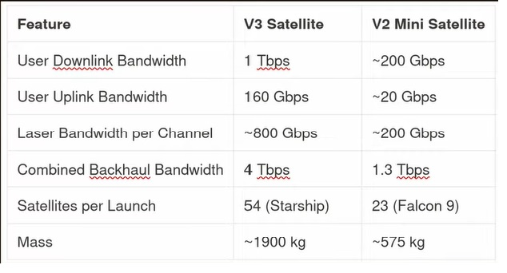
V2 Heavy Satellite
V2 Mini Satellite

Slide 5
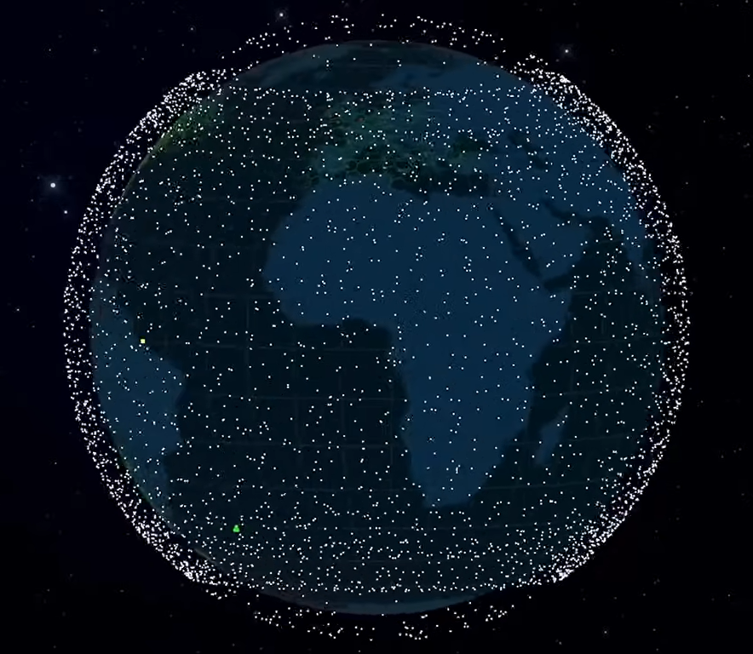

Slide 6
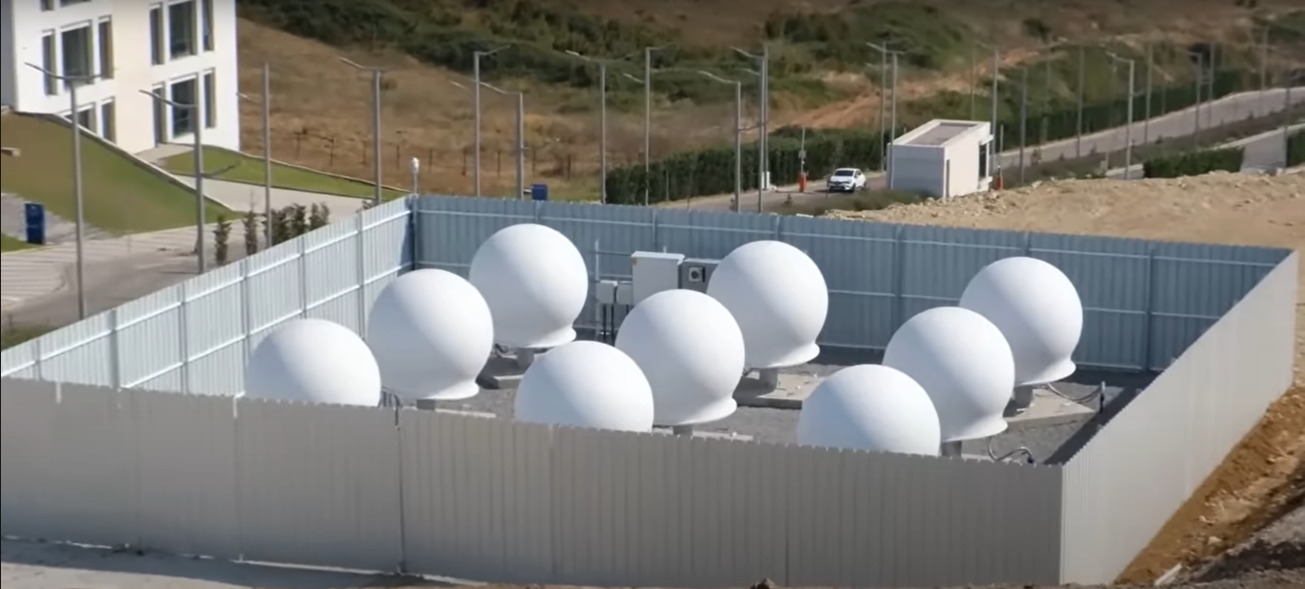
Starlink Ground Station Connect to POP Stations

Slide 7
Internal Parabolic Ant

Slide 8
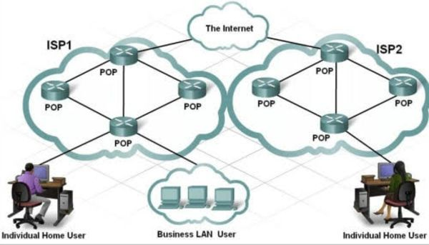
Point of Presence (POP) Where your WAN Address Connects to the Internet

Slide 9
Starlink Subscriber Terminals

Slide 10
Where to Point Starlink
Original Starlink (Dishy) aimed the dish for you
Newer models recommend via an app where to manually aim
Generally, away from the equator towards to poles, watch for obstructions
Will work in any orientation but generally will get best results
Northern Hemisphere aim north
Southern Hemisphere aim south
This is so not to interfere with GEO stationary SATs
Along the Continental Coasts, may be best oriented towards the ocean
Above the Arctic Circle may point South
Below Antarctic Circle may point North
An 8 to 14 degree tilt is best but will work fine laying flat especially while mobile

Slide 12
Setting up Starlink in Seaside, required me to aim it west and not North

Slide 13
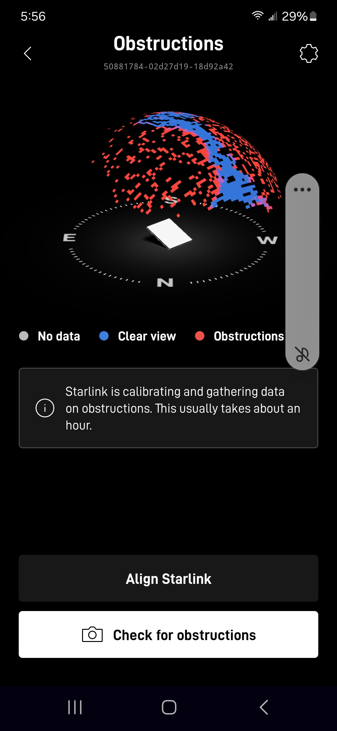
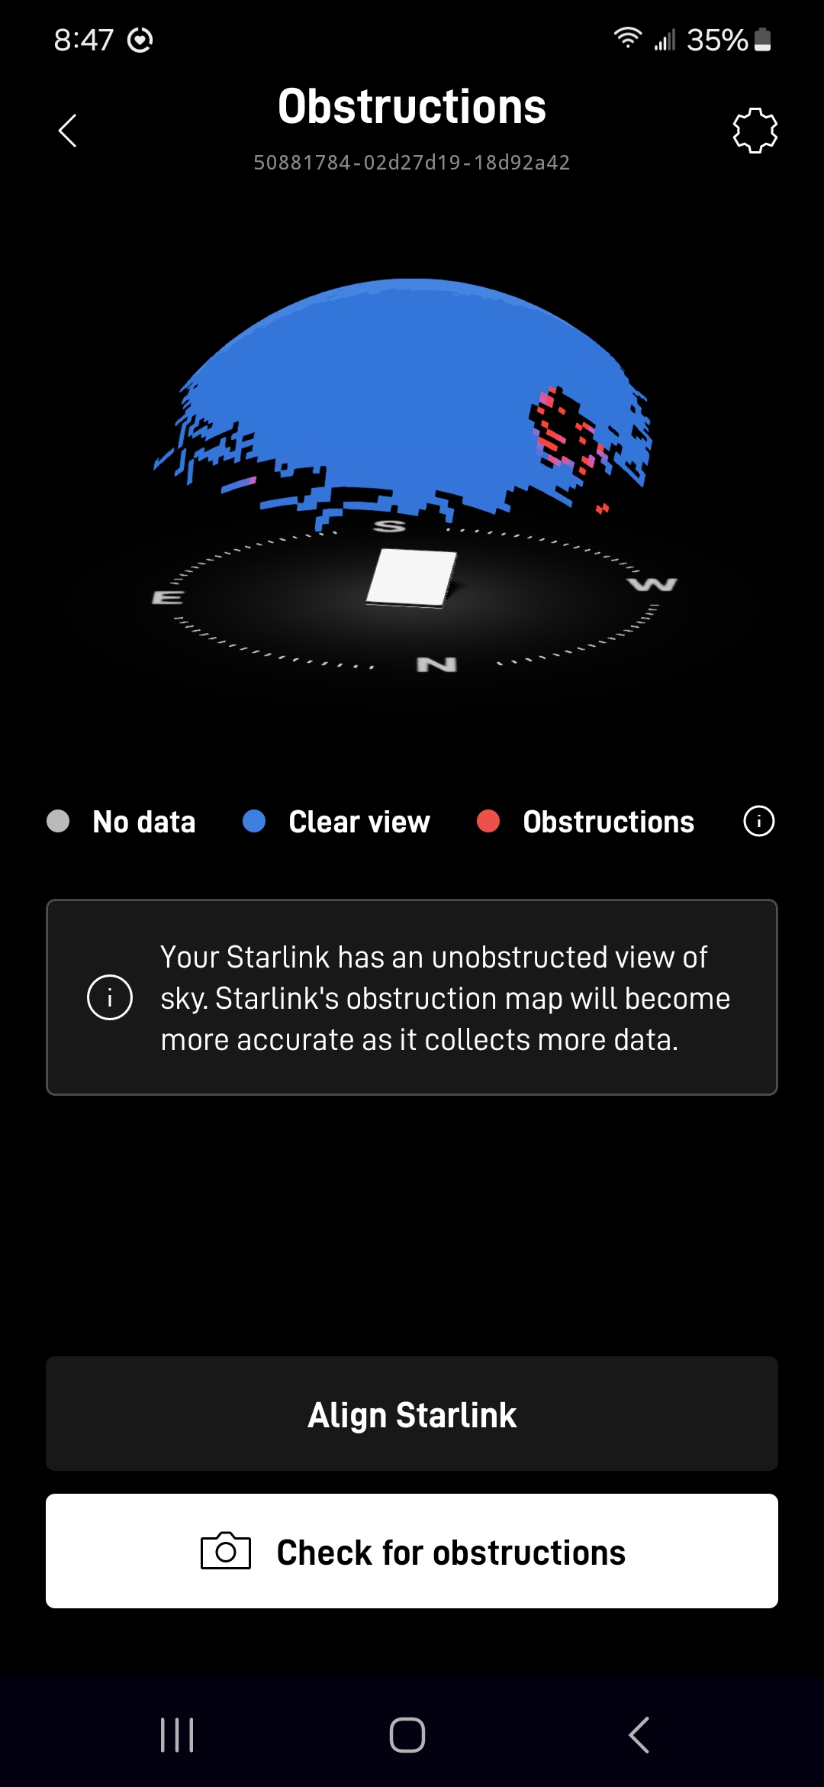

Slide 14
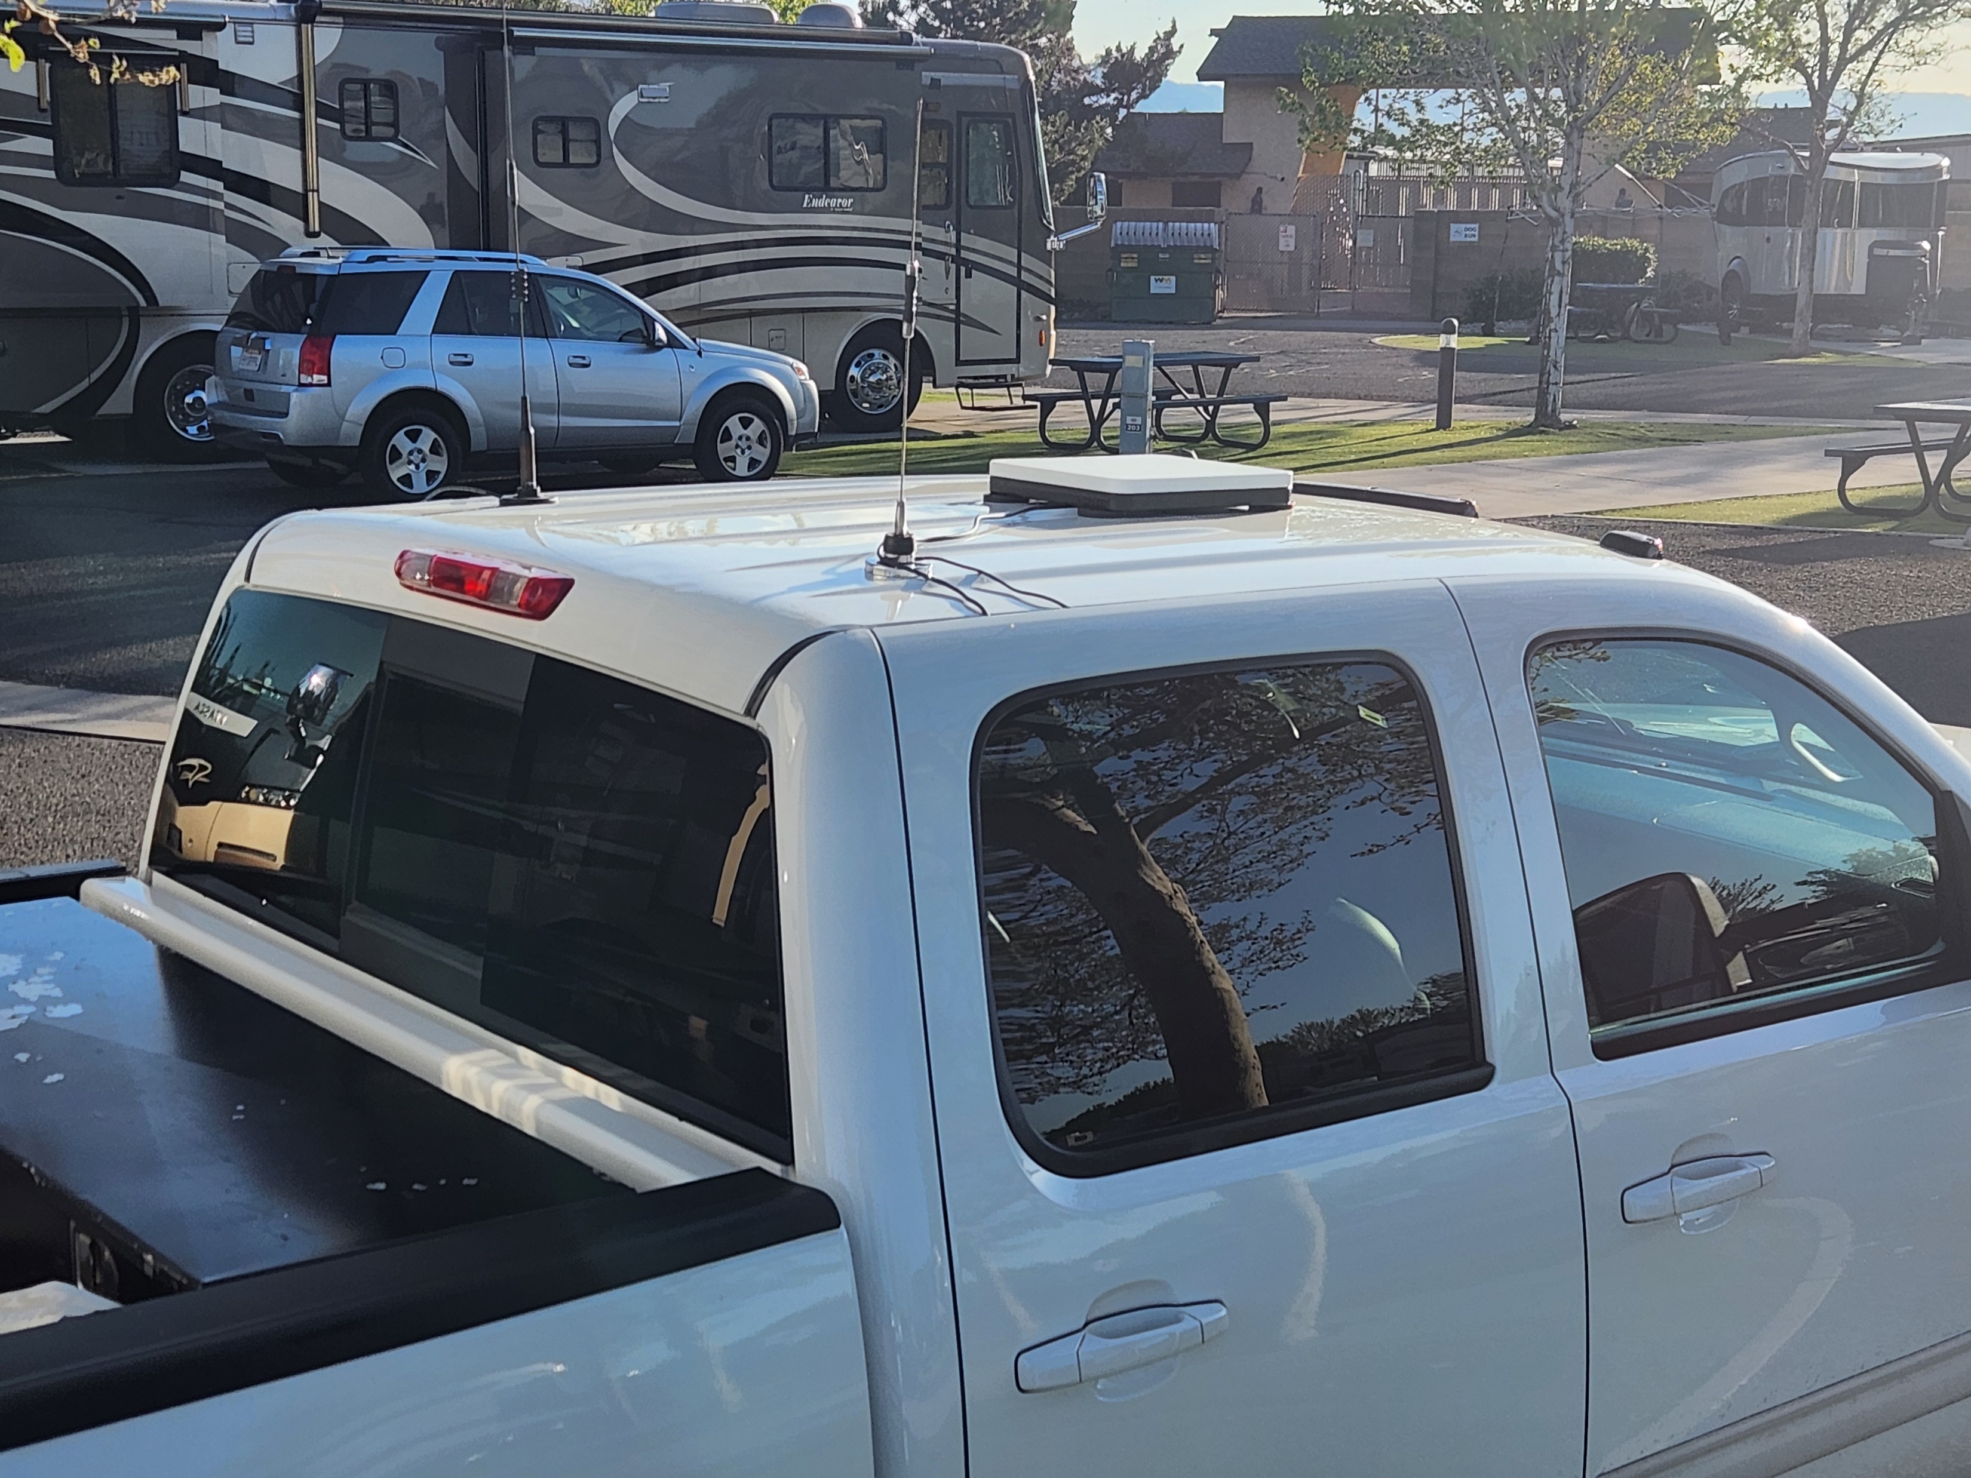
Starlink works laying flat and in any direction, but will work best when installed with a slope and pointed in the suggested direction

Slide 15
Service Plans
Go to www.starlink.com for latest information and rates
Fixed, Roam & Maritime Plans, NO LONG-TERM CONTRACTS
Residential & Business
Demand or Congestion Charges – and Wait Lists
Roam Plan can Pause and Un-Pause Service
Service Quality
Priority and Non Priority
Best Effort – up to service, ISP does its best effort up to a service or throughput, i.e, service up to 1Gbps
Access – paying for access, no guarantee of service or throughput
SLA – Service Level Agreement – Contract Speed and specific grade of service and repair…You purchase 1 Gbps symmetrical service minimum i.e. STARSHIELD for US DOD
Go to www.starlink.com for latest information and rates

Slide 16
Mini Antenna Power Requirements 12v – 48v DC
Runs at 20-25 watts with snow melt off, max is about 40 watts
AC power supply provides 30v at 2 amps = 60 watts
Found it best if minimum voltage is not less that 13v, drop out and antenna failures occur with lower voltage
Best to use shorter power cables, OEM 15m power cable works best with 20v or higher
USB-C PD (power delivery) 20v at 5 amps min = 100 watts with smart USB-C cord

Slide 17
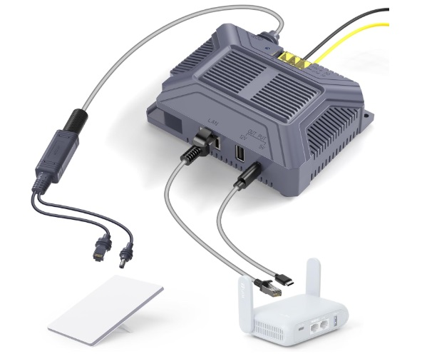
EDUP Starlink Mini CAT 5 POE 150 W Gig E DC up to 48V/3A for StarLink

Slide 18
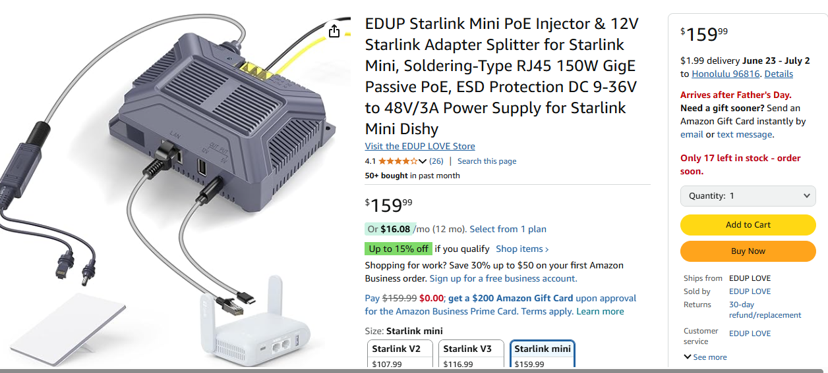

Slide 19
Questions/Answers & FAQ
Weather resistance with moisture tight plug
Provides CG-NAT service(like cellular service), no port forwarding
If you need port forwarding, must use a service capable of port forwarding or an external router using the pass-through Starlink setting (turns the internal router & WIFI off) or VPN service
Able to use Starlink WIFI with DMR Repeater (CAT-5) using an external router with port forwarding (port forwarding not needed w/cBridge)
Starlink speed is generally faster when bypassing Starlink router and using a 3rd party external router

Slide 20
Questions/Answers & FAQ
If terrestrial Internet service is available, terrestrial service is probably the better option over Starlink
As a backup or if you need service in a rural area not serviced by terrestrial Internet service, Starlink is a game changer.
If you are a traveling roamer like a boater, RVer or camper…Starlink is a game changer.
Plan changes that adjust to service coverage & demands will be often with Starlink. You will need to evaluate plan options often.
Currently $10-10GB, $50-50GB, & $165 unlimited Roaming Plans that can be paused
The business strategy of Elon Musk and Starlink, “would rather have 100 subscribers paying $200 per month than 200 subscribers paying $100 per month”. Plans adjust by regions, number of users, and ability to pay.

Slide 21
Questions/Answers Regarding Snow Melt
If power consumption is not factor and you have unlimited power source, select snow melt in Automatic Mode
If in mobile operation, leave snow melt in Automatic Mode
If power consumption is a factor and cold weather, snow, ice, sleet or rain is not a factor, turn snow melt off
Starlink antennas do not have a heater, they increase phase array power to melt snow/ice
Starlink antennas do not have temp gage, they measure S/N ratio and as it degrades it increases power, this process also improves mobile operations w/snow melt in auto mode

Slide 22
Questions/Answers & FAQ How to minimize Starlink Mini total usage per month?
Reduce or delay auto update services on devices connected
Firmware/OS updates
Synchronizing files, photos with cloud servers
Do these activities while on unlimited data plans
Minimize speed test while connected to Starlink
Use “Sleep Schedule” overnight when not using
Watch videos at a lower quality setting i.e. reducing 4k to 720p
Turn YouTube autoplay off

Slide 23
Why is Starlink so Vital to Hams

Slide 24
Questions/Answers & FAQ
I use a PACE Plan for all critical functions
Primary, Alternate, Contingency, Emergency
Communications (different smart phones with different service providers, radio RF (HF & VHF/UHF) SAT Service (InReach & Starlink). Also, out of state emergency contact/notification
Energy
Commercial power, Roof PV w/Powerwall Battery Backup, Generator, Powerwerks Box & portable batteries
Gasoline & Propane
Food/Water
Personal storage, coordinate additional resources with family
Shelter
Home, other family homes on same island, neighbor island family homes, mainland family homes, mainland RV

Slide 25
Starlink Supporting Winlink Q & A
Carter davis, KH6FV
Honolulu, HI

